Slide 1

UPPER MANYA KROBO DISTRICT ASSEMBLY
2025 COMPOSITE BUDGET HEARING

Slide 2
OUTLINE OF THE PRESENTATION
Introduction
Strategic Overview of the MMDA
Financial Performance – Revenue Expenditure
Key Achievements for 2024
2024 Budget Programme Performance
Outlook for 2025-2028
Conclusion

Slide 3
INTRODUCTION
Budget hearings are crucial part of Ghana’s Budget Management process where Assemblies revenue and expenditure estimates are examined in an open manner.
These hearings provide a platform for open discussions to examine the status of the District Medium Term Development Plan (DMTDP) implementation, assess targets based on previous year’s performance and verify alignment with government policies and expenditure priorities.
These efforts are geared to ensure Transparency, Accountability, Better decision-making and enhanced citizens’ engagement.

Slide 4
STRATEGIC OVERVIEW OF THE DISTRICT
NAME OF THE DISTRICT: Upper Manya Krobo District Assembly.
The Legislative Instrument, 2008 (L.I 1842) established the Upper Manya Krobo District Assembly in February, 2008, with Asesewa as its Capital. It forms part of the Thirty-Three (33) Municipals and Districts Assemblies in the Eastern Region of Ghana.
POPULATION SIZE
The 2024 Population of Upper Manya Krobo District is 77,744 comprising 39,182 males representing fifty-one percent (51%) and 38,562 Females forty-nine percent (49%).

Slide 5
VISION
A Safe, Prosperous and Responsive Model District.
GOALS
Upper Manya Krobo District aims to improving the wellbeing of the people through the collaboration with civic society and the private sector in the provision of socio-economic infrastructure and improved service delivery.
MISSION
To improve the quality of life of the people and the environment through efficient resource mobilization and sound development administration.

Slide 6
CORE FUNCTIONS OF THE DISTRICT ASSEMBLY
The core functions of the District Assembly are outlined below:
Responsible for the overall development of the District and ensure the preparation and submission of Development Plans and Budget of the district through the Regional Co-ordinating Council to the Central Government.
Formulate and execute plans, programmes and strategies for effective mobilization of resources necessary for the overall development of the district.
Promote and support productive activities and social development in the district and remove obstacles to initiate development.

Slide 7
CORE FUNCTIONS OF THE DISTRICT ASSEMBLY
Cont..
Monitor and execute projects under approved Development Plans and assess and evaluate their impact on the people’s lives in the district.
Responsible for maintenance of security and public safety in the district in cooperation with the appropriate security agencies.
(Source Local Government Act 936 of 2016)

Slide 8
MMDA ADOPTED POLICY OBJECTIVES
FOCUS AREA | ADOPTED POLICY OBJECTIVE
Local Government and Decentralization | Deepen political, Administrative and Fiscal Decentralization
Education and Training | Enhance inclusive and equitable access to, and participation in quality education at all levels.
Health and Health Services | Bridge the equity gaps in access to Health care in the District
Environmental Sanitation Management | Improve Environmental Sanitation in the District
Social Protection Gender Equality Child Protection and Development Disability Inclusive Development | Improve the livelihoods of the poor, vulnerable and marginalized in the District (Child Protection and Development, Social Protection Interventions, Persons with Disability, Gender Equality and Women

Slide 9
MMDA ADOPTED POLICY OBJECTIVES
FOCUS AREA | POLICY OBJECTIVE
Human Settlement Development and Housing Road Infrastructure Water Infrastructure | Improve Infrastructural delivery and promote a sustainable, spatially Integrated, balanced and orderly development of human settlements in the District
Agricultural and Rural Development | Improve production efficiency and yield.
Private Sector and Tourism Development | Improve Private Sector productivity and competitiveness
Disaster Management | Promote proactive planning for disaster prevention and mitigation.

Slide 10
STRATEGIC OVERVIEW OF THE MMDA
DISTRICT ECONOMY
LOCATION AND SIZE
The District is located in the North-Eastern corner of the Eastern Region. It covers an area of 885 square kilometers constituting 4.6 percent of the region’s land size (19,323km²).
The Upper Manya Krobo District shares common boundaries with Afram Plains to the North, Lower Manya Krobo District to the South-East, Yilo Krobo District to South-West, Asuogyaman District to the East and Fanteakwa District to the West.
AGRICULTURE
The District economy is mainly agrarian with commerce and a few industrial activities. Data from Agric annual progress report indicates that 73% of the District population is employed in the agriculture sector and its related trades; with the highest cultivating crops and a fraction in livestock and fishing. `

Slide 11
STRATEGIC OVERVIEW OF THE MMDA
DISTRICT ECONOMY
ROAD
The District is characterized by a network of feeder roads of about 300km in total that are generally deplorable especially in the rainy season. This affects transportation of farm produce from the farm gates to the market centers. Roads linking major towns like Akateng and Sekesua to the District Capital are tarred.
EDUCATION
The District has a total number of Two Hundred and Sixty-One (261) educational facilities for both public and private; comprising Nighty-Eight (98) Kindergartens, One Hundred and Twenty-One (121) Primary, Forty-One (41) Junior High Schools, and One (1) Senior High School (SHS). This is woefully inadequate considering the growing population of the District.

Slide 12
STRATEGIC OVERVIEW OF THE MMDA
DISTRICT ECONOMY
HEALTH
The District has One (1) Hospital, Three (3) Maternity Homes, Four (4) Health Centres and Forty-Two (42) Community-Based Health Planning and Services (CHPS) Compounds. A major challenge affecting access to quality health care in the District is poor and inadequate infrastructure.
ENVIRONMENT
Generally, with an undulating topography, the highest point in the District is over 660 meters above sea level located in the southern part of District and the lowest area about 50 meters above sea level. The average height of the land is about 452 meters above sea level. Underlying these landmasses are several rocks or parent rocks from which several rocks have developed.

Slide 13
STRATEGIC OVERVIEW OF THE MMDA
DISTRICT ECONOMY
SANITATION
District has Two (2) Final Disposal Sites that are regularly sprayed and graded biannually. Both Solid and Liquid waste generated from public places are managed and disposed off by the Zoom Lion Ghana Limited and supervised by the Environmental Health and Sanitation Unit (EHSU).
TOURISM
The Upper Manya Krobo District is endowed with Nine (9) undeveloped wonderful Tourist Sites that the Assembly is in the process of developing.
Amongst them are three commercially viable falls, a cave and a very beautiful canopy of trees on a mountain and also historic market center at Asesewa.

Slide 14
KEY DEVELOPMENT ISSUES/CHALLENGES
The following is the list of key development issues of the Upper Manya Krobo District Assembly which the 2025-2028 Programme Based Budget seeks to address:
Deplorable road network conditions linking the farming communities to the market centers
Inadequate access to potable drinking water
Dilapidated and inadequate educational infrastructure
Inadequate access to quality healthcare delivery
Poor solid and liquid waste management
High unemployment and underemployment among the youth

Slide 15
KEY DEVELOPMENT ISSUES/CHALLENGES
Poor land use management
Inadequate social protection especially support for the needy and vulnerable, i.e. inadequate support for PWDs, people living with HIV/AIDS, Vulnerable Children, the aged and poor in society
Inadequate Internally Generated Funds (IGF)
High incidents of seasonal floods and fire disaster

Slide 16
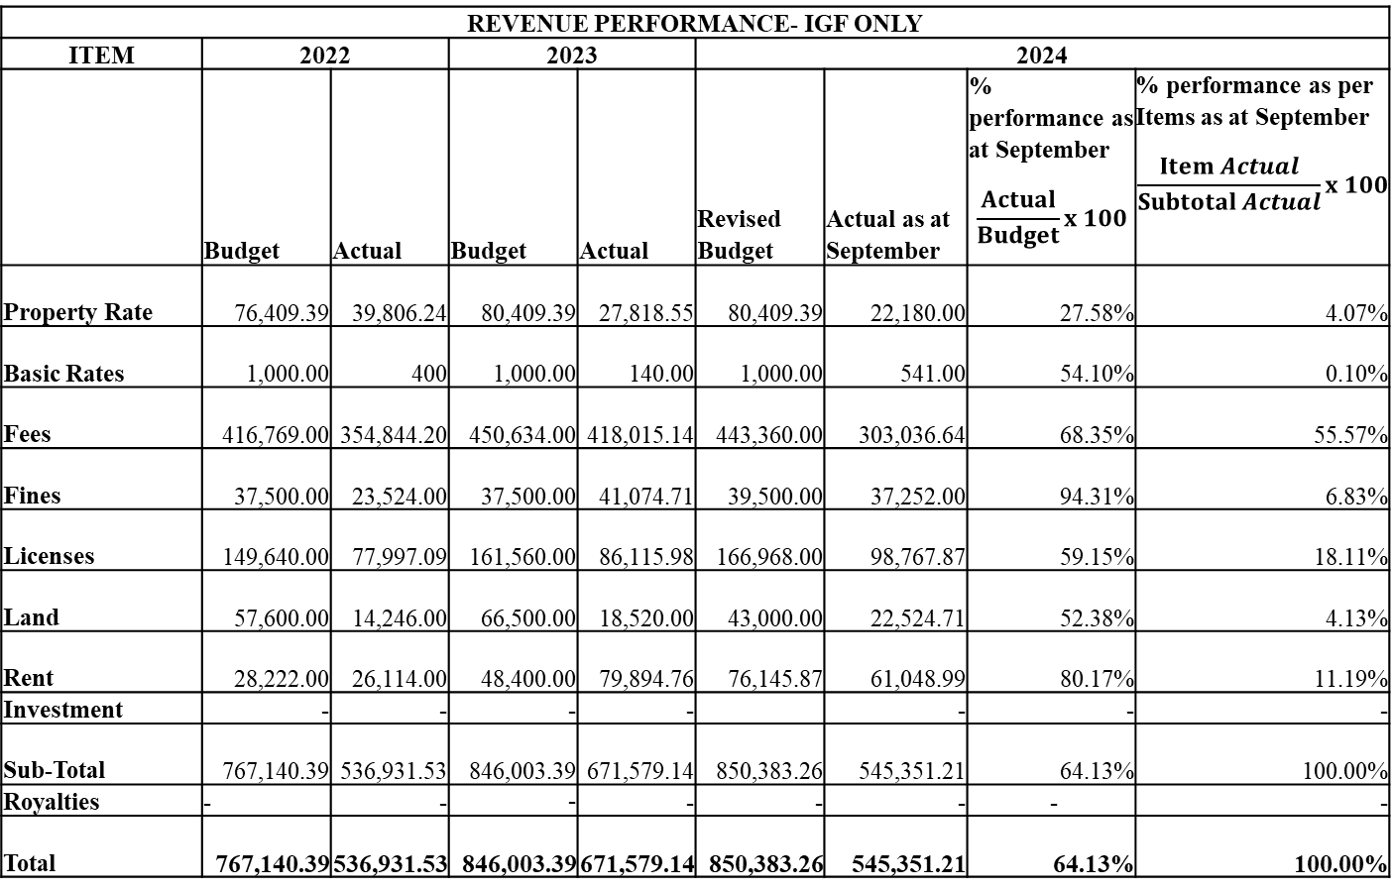
FINANCIAL PERFORMANCE - REVENUE
REVENUE PERFORMANCE- IGF ONLY
ITEM | 2022 |  | 2023 |  | 2024
 | Budget | Actual | Budget | Actual | Revised Budget | Actual as at September | % performance as at September $$\frac{Actual}{Budget}x 100$$ | % performance as per Items as at September $$\frac{Item Actual}{Subtotal Actual}x 100$$
Property Rate | 76,409.39 | 39,806.24 | 80,409.39 | 27,818.55 | 80,409.39 | 22,180.00 | 27.58% | 4.07%
Basic Rates | 1,000.00 | 400 | 1,000.00 | 140.00 | 1,000.00 | 541.00 | 54.10% | 0.10%
Fees | 416,769.00 | 354,844.20 | 450,634.00 | 418,015.14 | 443,360.00 | 303,036.64 | 68.35% | 55.57%
Fines | 37,500.00 | 23,524.00 | 37,500.00 | 41,074.71 | 39,500.00 | 37,252.00 | 94.31% | 6.83%
Licenses | 149,640.00 | 77,997.09 | 161,560.00 | 86,115.98 | 166,968.00 | 98,767.87 | 59.15% | 18.11%
Land | 57,600.00 | 14,246.00 | 66,500.00 | 18,520.00 | 43,000.00 | 22,524.71 | 52.38% | 4.13%
Rent | 28,222.00 | 26,114.00 | 48,400.00 | 79,894.76 | 76,145.87 | 61,048.99 | 80.17% | 11.19%
Investment | - | - | - | - |  | - | - | -
Sub-Total | 767,140.39 | 536,931.53 | 846,003.39 | 671,579.14 | 850,383.26 | 545,351.21 | 64.13% | 100.00%
Royalties | - | - | - | - | - | - | - | -
Total | 767,140.39 | 536,931.53 | 846,003.39 | 671,579.14 | 850,383.26 | 545,351.21 | 64.13% | 100.00%
NB. The percentage performance for IGF considers the individual contribution of each revenue item to the actual receipts as at September, 2024

Slide 17
STRATEGIES TO IMPROVE REVENUE MOBILIZATION
Intensification of ‘’Management Day Out’’ to participate in Revenue Collection and also monitor the activities of the Revenue collectors.
Installation of gantry points linking to the various communities to cease all loopholes in the Revenue Mobilization.
Strengthening of Sub-District Structures to collect ceded revenues.
Organize regular (quarterly basis) training workshop for the revenue collectors.
Recruitment of additional revenue or commission collectors to augment the existing number.
Carrying out of Public Education and Sensitization in the District to encourage members of the general public to honour their tax obligations to the Assembly.
Formation of revenue Tax force to augment the effort of the Revenue officers to enable the Assembly achieve revenue projection for fiscal year.

Slide 18
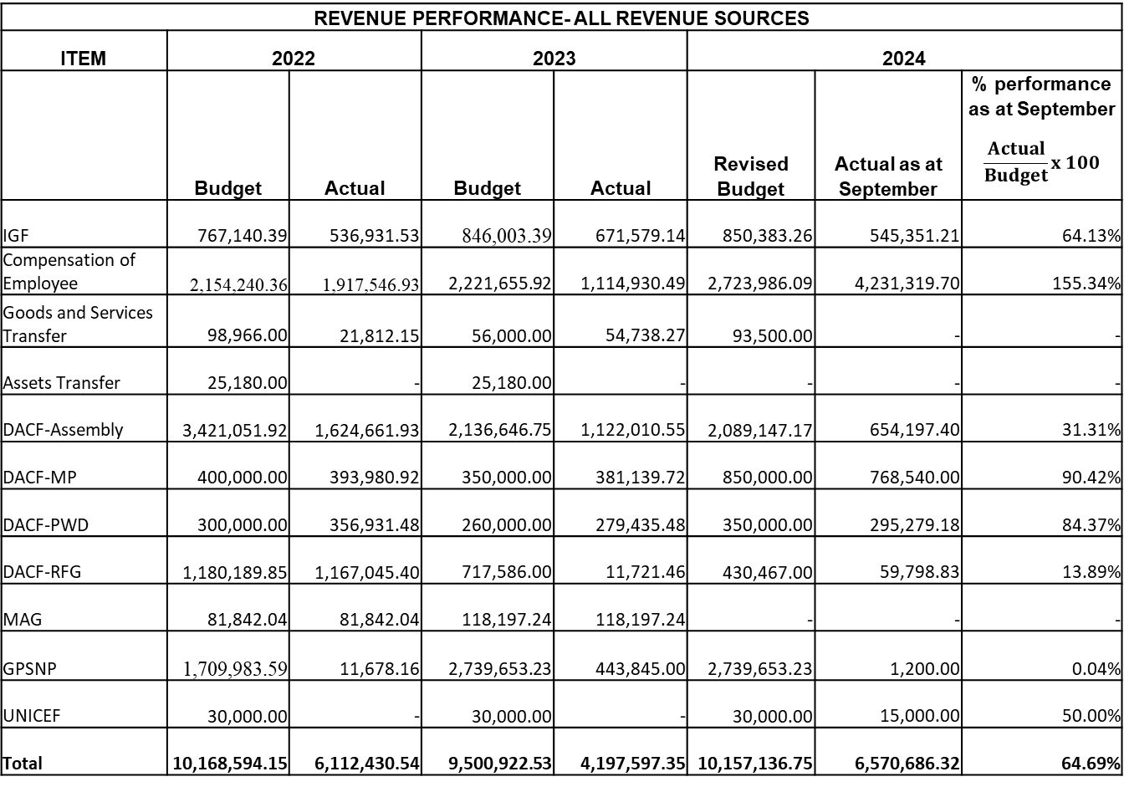
FINANCIAL PERFORMANCE - REVENUE
REVENUE PERFORMANCE- ALL REVENUE SOURCES
ITEM | 2022 |  | 2023 |  | 2024
 | Budget | Actual | Budget | Actual | Revised Budget | Actual as at September | % performance as at September $$\frac{Actual}{Budget}x 100$$
IGF | 767,140.39 | 536,931.53 | 846,003.39 | 671,579.14 | 850,383.26 | 545,351.21 | 64.13%
Compensation of Employee | 2,154,240.36 | 1,917,546.93 | 2,221,655.92 | 1,114,930.49 | 2,723,986.09 | 4,231,319.70 | 155.34%
Goods and Services Transfer | 98,966.00 | 21,812.15 | 56,000.00 | 54,738.27 | 93,500.00 | - | -
Assets Transfer | 25,180.00 | - | 25,180.00 | - | - | - | -
DACF-Assembly | 3,421,051.92 | 1,624,661.93 | 2,136,646.75 | 1,122,010.55 | 2,089,147.17 | 654,197.40 | 31.31%
DACF-MP | 400,000.00 | 393,980.92 | 350,000.00 | 381,139.72 | 850,000.00 | 768,540.00 | 90.42%
DACF-PWD | 300,000.00 | 356,931.48 | 260,000.00 | 279,435.48 | 350,000.00 | 295,279.18 | 84.37%
DACF-RFG | 1,180,189.85 | 1,167,045.40 | 717,586.00 | 11,721.46 | 430,467.00 | 59,798.83 | 13.89%
MAG | 81,842.04 | 81,842.04 | 118,197.24 | 118,197.24 | - | - | -
GPSNP | 1,709,983.59 | 11,678.16 | 2,739,653.23 | 443,845.00 | 2,739,653.23 | 1,200.00 | 0.04%
UNICEF | 30,000.00 | - | 30,000.00 | - | 30,000.00 | 15,000.00 | 50.00%
Total | 10,168,594.15 | 6,112,430.54 | 9,500,922.53 | 4,197,597.35 | 10,157,136.75 | 6,570,686.32 | 64.69%
NB. The District Assembly’s Common Fund (CF) estimate and actuals include the HIV/AIDS Fund

Slide 19
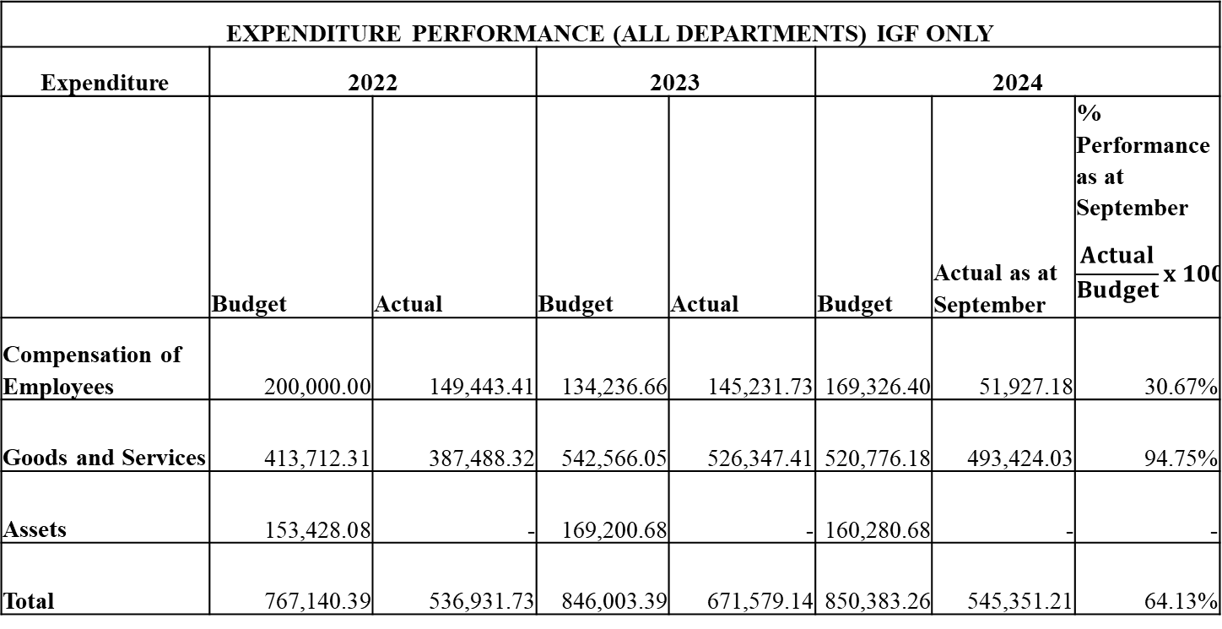
FINANCIAL PERFORMANCE – EXPENDITURE CONT’D.
EXPENDITURE PERFORMANCE (ALL DEPARTMENTS) IGF ONLY
Expenditure | 2022 |  | 2023 |  | 2024
 | Budget | Actual | Budget | Actual | Budget | Actual as at September | % Performance as at September $$\frac{Actual}{Budget}x 100$$
Compensation of Employees | 200,000.00 | 149,443.41 | 134,236.66 | 145,231.73 | 169,326.40 | 51,927.18 | 30.67%
Goods and Services | 413,712.31 | 387,488.32 | 542,566.05 | 526,347.41 | 520,776.18 | 493,424.03 | 94.75%
Assets | 153,428.08 | - | 169,200.68 | - | 160,280.68 | - | -
Total | 767,140.39 | 536,931.73 | 846,003.39 | 671,579.14 | 850,383.26 | 545,351.21 | 64.13%

Slide 20
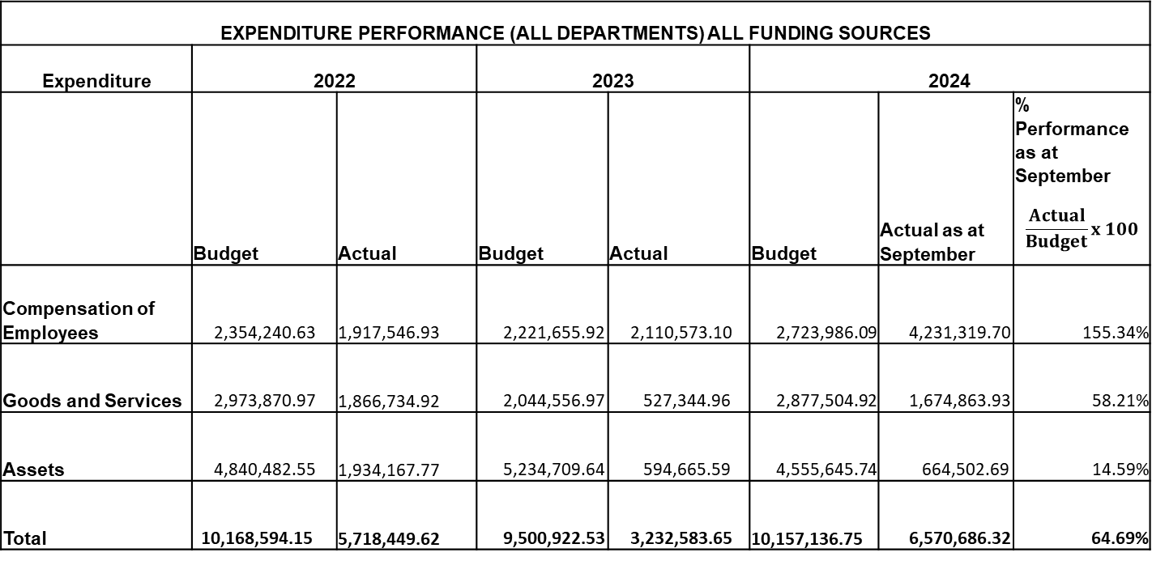
FINANCIAL PERFORMANCE – EXPENDITURE CONT’D.
EXPENDITURE PERFORMANCE (ALL DEPARTMENTS) ALL FUNDING SOURCES
Expenditure | 2022 |  | 2023 |  | 2024
 | Budget | Actual | Budget | Actual | Budget | Actual as at September | % Performance as at September $$\frac{Actual}{Budget}x 100$$
Compensation of Employees | 2,354,240.63 | 1,917,546.93 | 2,221,655.92 | 2,110,573.10 | 2,723,986.09 | 4,231,319.70 | 155.34%
Goods and Services | 2,973,870.97 | 1,866,734.92 | 2,044,556.97 | 527,344.96 | 2,877,504.92 | 1,674,863.93 | 58.21%
Assets | 4,840,482.55 | 1,934,167.77 | 5,234,709.64 | 594,665.59 | 4,555,645.74 | 664,502.69 | 14.59%
Total | 10,168,594.15 | 5,718,449.62 | 9,500,922.53 | 3,232,583.65 | 10,157,136.75 | 6,570,686.32 | 64.69%

Slide 21
Expenditure By Budget Programme And Economic Classification-all Funding Sources as at September 2024
BUDGET PROGRAMME | AMOUNT GH¢6,570,686.32
 | BUDGET | COMPENSATION OF EMPLOYEES | GOODS & SERVICE | CAPITAL EXPENDITURE | TOTAL
Management and Administration | 2,934,954.35 | 2,708,467.97 | 754,863.93 | - | 3,463,331.90
Social Services Delivery | 2,007,934.98 | 605,564.63 | 526,240.00 | 20,000.00 | 1,151,804.63
Infrastructure Delivery and Management | 2,634,614.31 | 285,129.87 | 42,190.00 | 964,502.69 | 1,291,822.56
Economic Development | 2,560,626.43 | 632,157.23 | 28,570.00 | - | 660,727.23
Environmental Management | 19,006.68 | - | 3,000.00 | - | 3,000.00
TOTAL | 10,157,136.75 | 4,231,319.70 | 1,354,863.93 | 984,502.69 | 6,570,686.32

Slide 22
2024 KEY PROJECTS AND PROGRAMMES FROM ALL FUNDING SOURCES
No | Name of project / Programme | Amount budgeted | Actual Payment as at September, 2024 | Outstanding Payment
1 | Construction of CHPS compound at Ponponya Fanten | 170,217.21 | 106,384.54 | 63,832.67
2 | Construction of 3-storey administration block at Asesewa | 3,402,425.95 | 1,642,237.75 | 1,760,188.20
3 | Construction of 6-unit classroom block with ancillary facilities at Akotoklo-Gua | 547,631.55 | - | 547,631.55
4 | Rehabilitation of DCE’s official residence | 97,103.72 | 60,000.00 | 37,103.72

Slide 23
2024 KEY PROJECTS AND PROGRAMMES FROM ALL FUNDING SOURCES
No | Name of Project / Programme | Amount budgeted | Actual Payment as at September, 2024 | Outstanding payment
5 | Re-gravelling and spot improvement of access roads in the Asesewa Market | 9,950.00 | - | 9,950.00
6 | Pavement of Asesewa lorry park (Phase 1) | 514,439.82 | 240,000.00 | 274,439.82
7 | Construction of washroom facilities for Upper Manya Krobo District Assembly (old block) | 78,417.60 | 40,000.00 | 38,417.60
8 | Construction of washroom facilities for Upper Manya Krobo District Assembly (old block) | 78,417.60 | 40,000.00 | 38,417.60

Slide 24
2024 KEY PROJECTS AND PROGRAMMES FROM ALL FUNDING SOURCES
No | Name of Project / Programme | Amount budgeted | Actual Payment as at September, 2024 | Outstanding payment
9 | Reshaping of road from Asesewa - Awoworsu | 334,186.00 | 322,738.75 | 11,447.25
10 | Renovation of Asesewa Anglican Primary School at Asesewa. | 176,102.60 | 13,000.00 | 163,102.60
11 | Renovation of DCE/DCD/DFO Office at the old Assembly block,Asesewa. | 59,836.00 | 40,000.00 | 19,836.00
12 | Construction of 3-unit classroom pavilion at Asesewa Anglican School. | 97,059.90 | 13,000.00 | 84,059.90
13 | Construction of 1no. 6-unit classroom pavilion with office and store at Nyoenyoem. | 180,002.80 | 154,802.40 | 25,200.40

Slide 25
2024 KEY PROJECTS AND PROGRAMMES FROM ALL FUNDING SOURCES
No | Name of project | Amount budgeted | Actual Payment as at September, 2024 | Outstanding payment
14 | Renovation and extension of Sekesua Police Station UMKDA/DACF/WKS/007/2022. | 88,957.00 | 75,000.00 | 13,957.00
15 | Renovation and partitioning of office for Upper Manya Krobo District Assembly ( old block,) Asesewa | 35,716.28 | - | 35,716.28
 | TOTAL | 5,792,046.43 | 2,707,163.44 | 3,084,882.99

Slide 26
NON FINANCIAL PERFORMANCE BY PROGRAMMES

Slide 27
KEY ACHIEVEMENTS (2024)
Distributed 200 dual desks to selected Schools in the District donated by GET Fund
Construction of Market sheds at Sekesua (Ongoing project)
Mechanized boreholes with over head tanks at Akumersu, Nyonyeom and Nyakumase
Rehabilitation of 17Ha degraded Communal Land using Oil Palm Trees at Abesere (GPSNP 2 LIPW)
Rehabilitation of 10Ha degraded Communal Land using Cashew Trees at Akotoe (GPSNP 2 LIPW)
Presentation of Tricycle to PWD beneficiary
Presentation of Cassava Milling Machines to PWDs
Supplied 31,464 Oil Palm seedlings to Farmers (PERD)
Supply of 4,000 Coconut Seedlings to Farmers

Slide 28
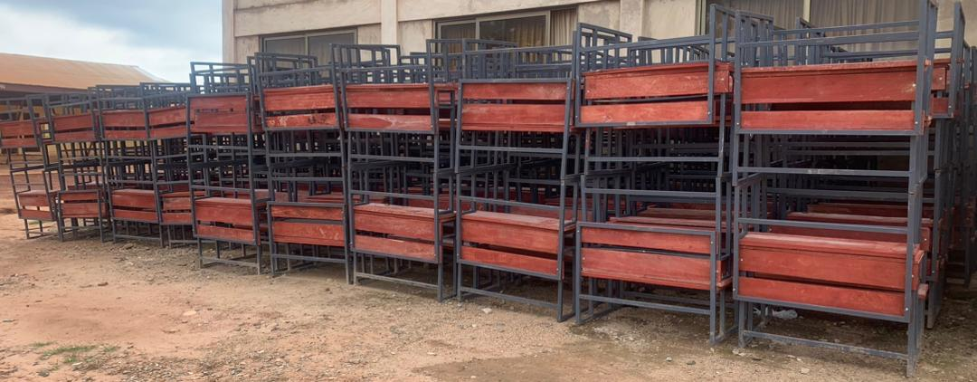
KEY ACHIEVEMENTS (2024)
. Distributed 200 dual desks to selected Schools in the District donated by GET Fund

Slide 29
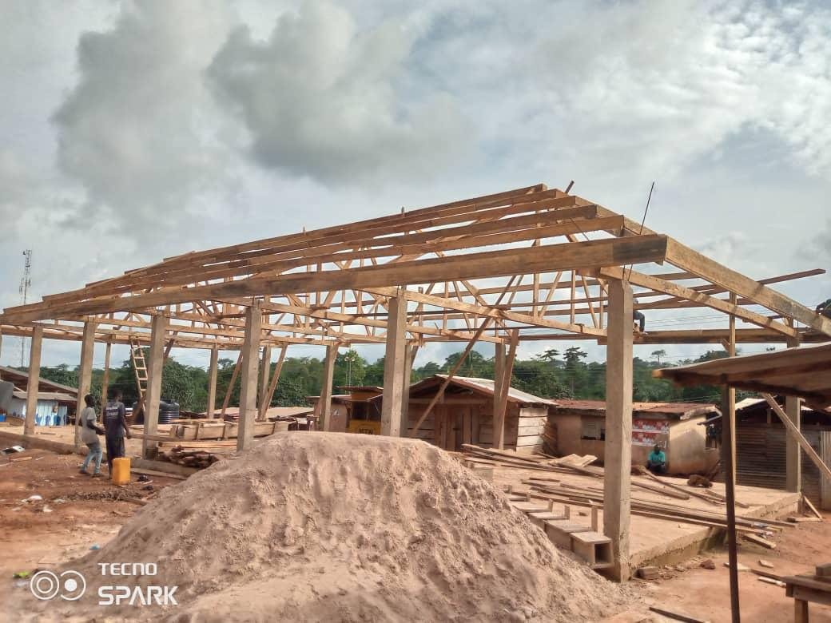
KEY ACHIEVEMENTS (2024)
Construction of Market sheds at Sekesua (Ongoing project)

Slide 30
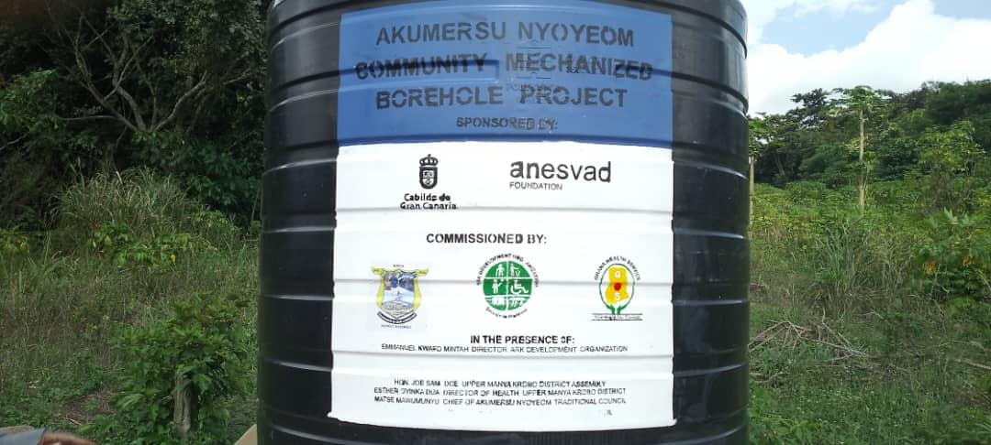
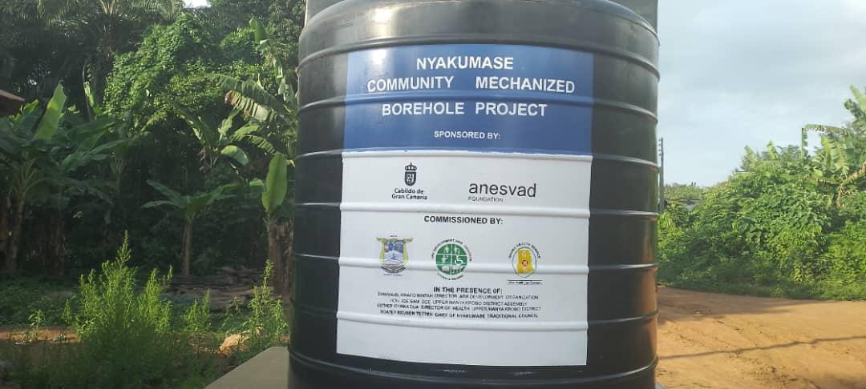
Mechanized boreholes with over head tanks at Akumersu, Nyonyeom and Nyakumase

Slide 31
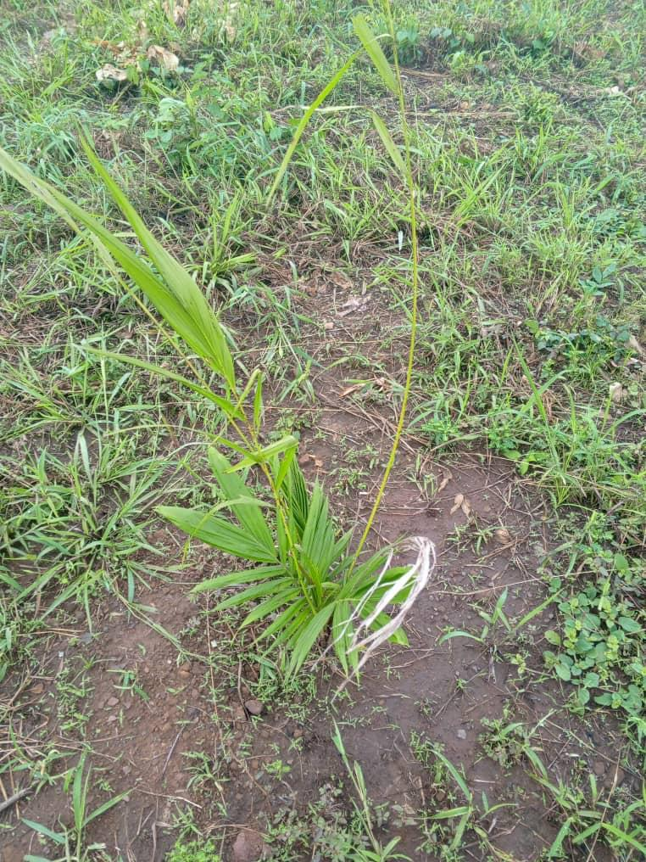
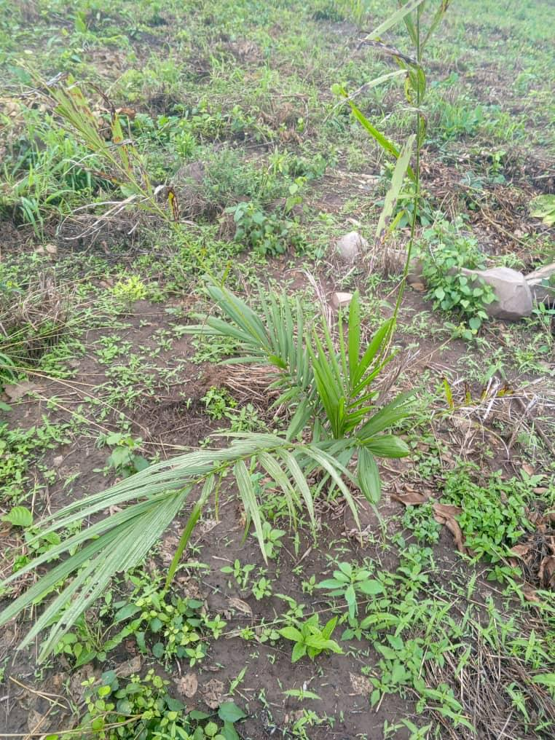
Rehabilitation of 17Ha degraded Communal Land using Oil Palm Trees at Abesere (GPSNP 2 LIPW)

Slide 32
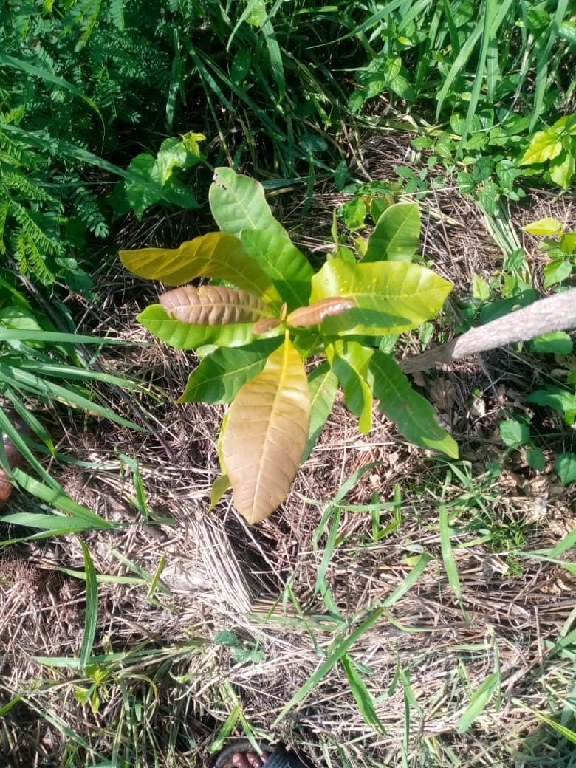
Rehabilitation of 10Ha degraded Communal Land using Cashew Trees at Akotoe (GPSNP 2 LIPW)

Slide 33
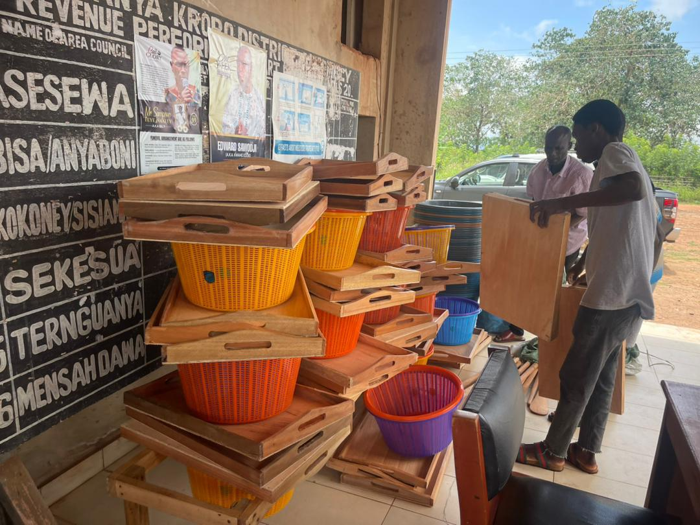
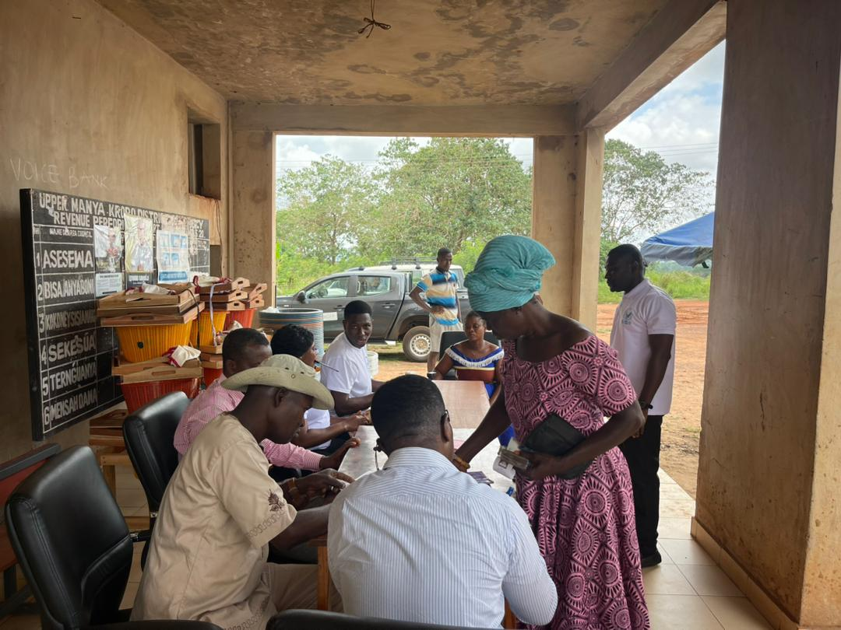
GPSNP 2 PI COMPONENT ‘S MINI MARKET AT ASESEWA

Slide 34
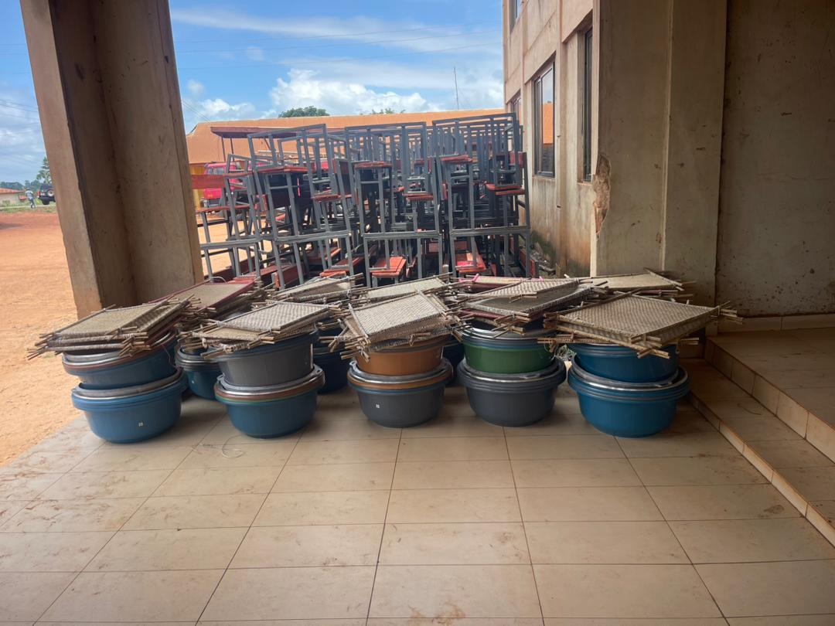
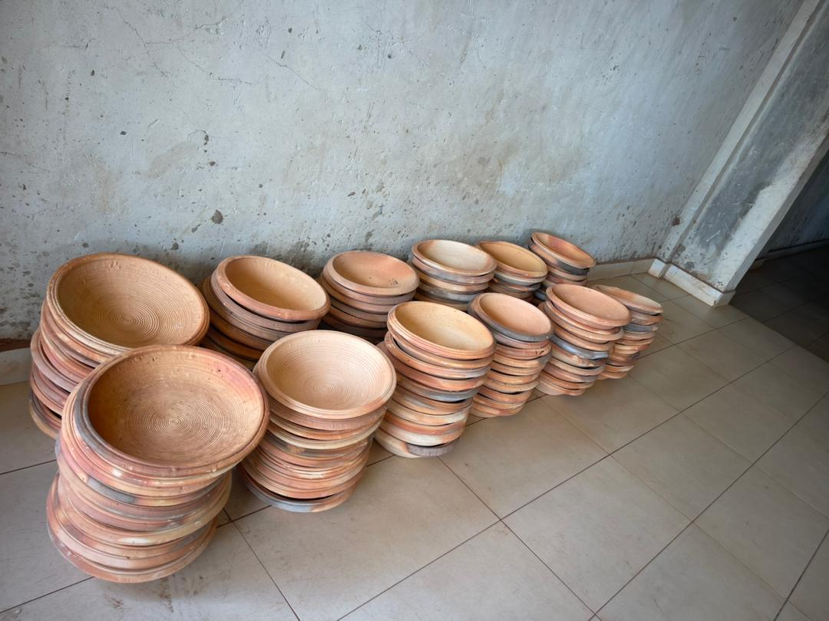
CONT……

Slide 35
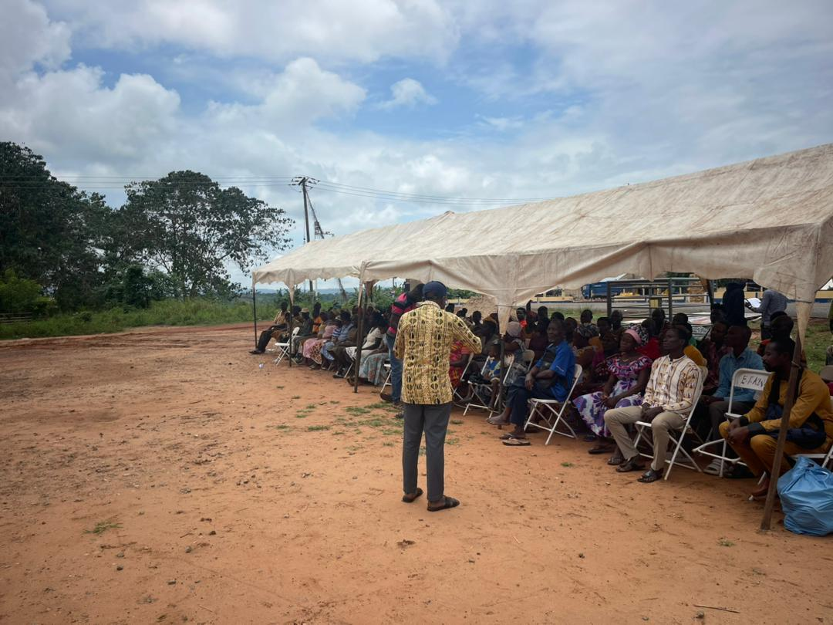
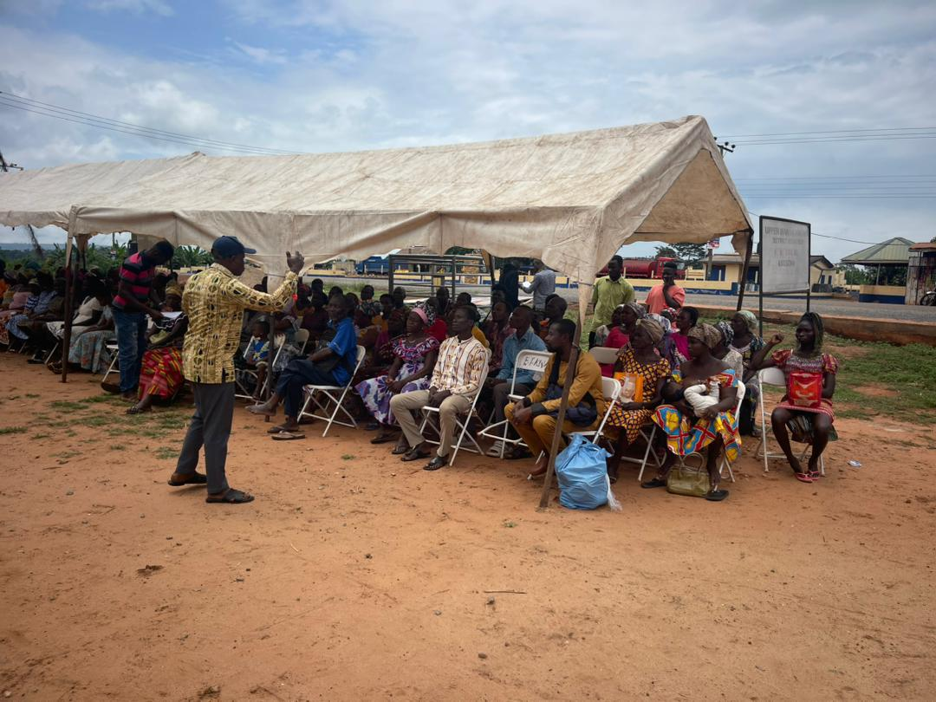
CONT…..

Slide 36
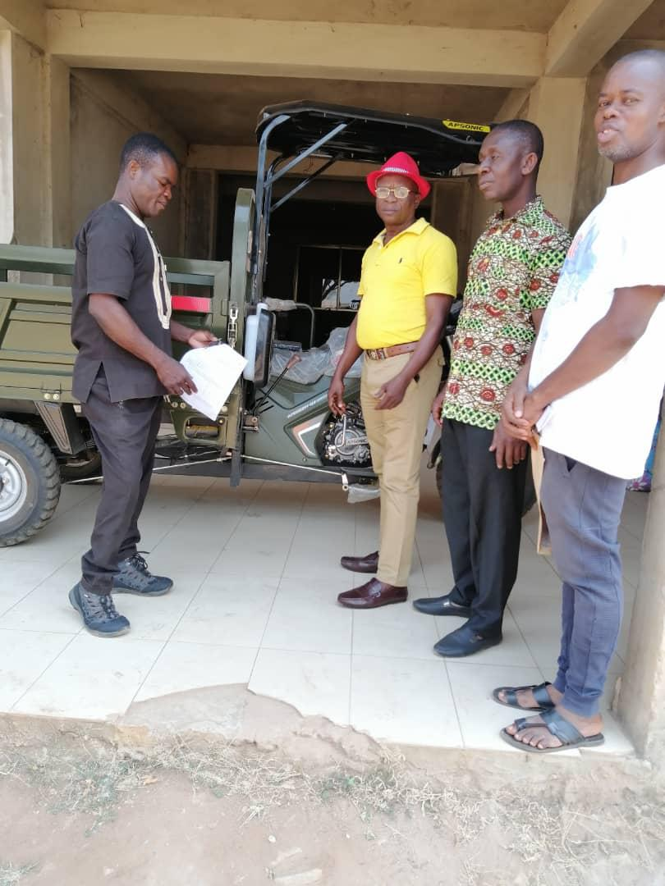
Presentation of Tricycle to PWD beneficiary

Slide 37
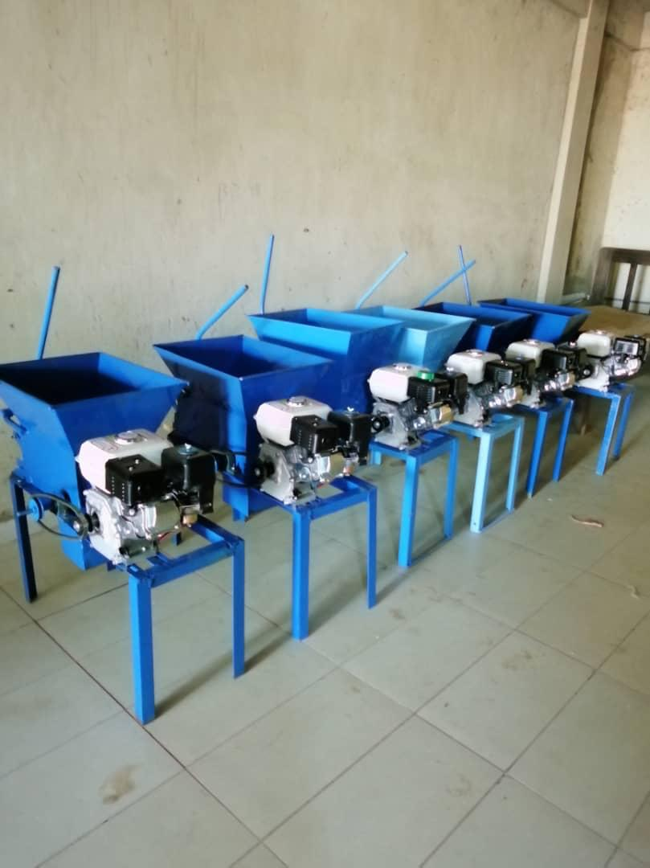
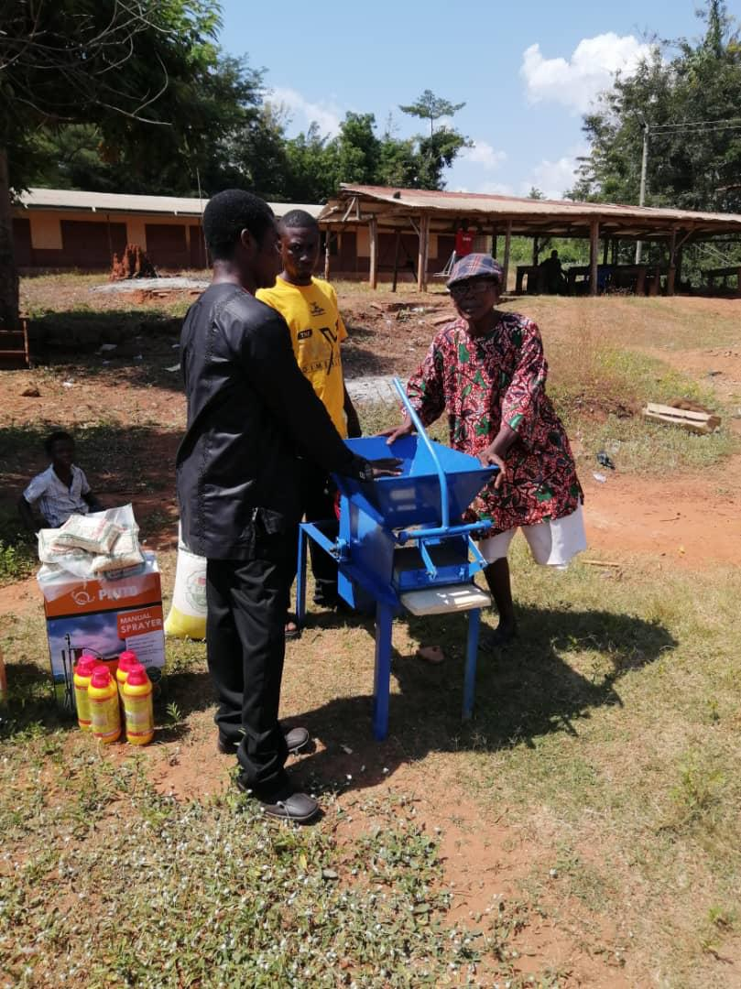
Presentation of Cassava Milling Machines to PWDs

Slide 38
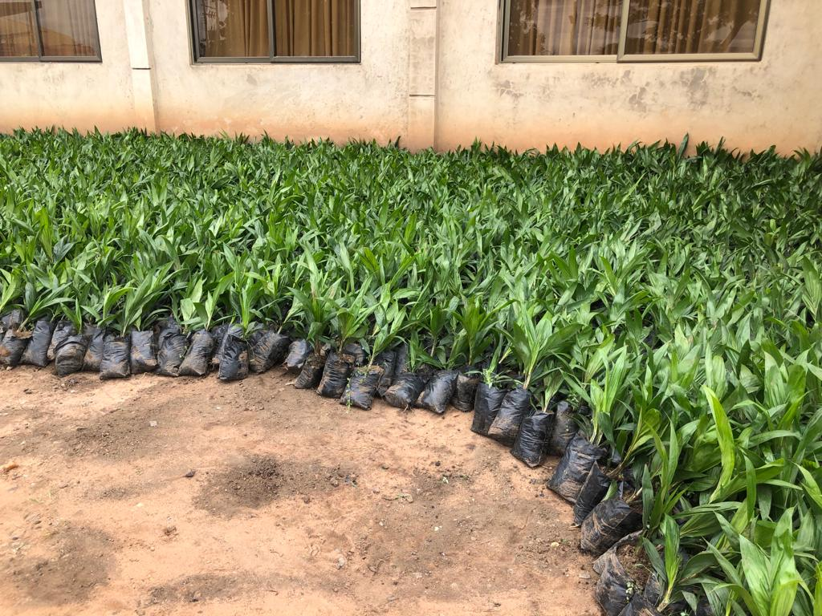
Supplied 31,464 Oil Palm seedlings to Farmers (PERD)

Slide 39
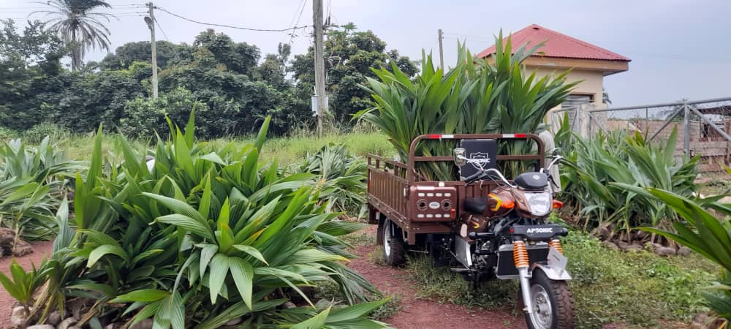
Supply of 4,000 Coconut Seedlings to Farmers

Slide 40
POLICY OUTCOME INDICATORS AND TARGETS
Outcome Indicator | Outcome Indicator Description | Unit of Measurement | Previous year’s performance (2023) |  | Current year’s Actual Performance (2024)
 |  |  | Target | Actual | Target | Actuals as at September
Improved Basic School Performance | Improved BECE Results performance | Percentage of pupils passed BECE | 68% | 88.1% | 80% | N/A
Improved support to PWDs | Improved Livelihood of the poor, vulnerable and marginalized in the District | Percentage of registered persons with Disability engage in Productive economic activities | 60% | 45% | 60% | 40%

Slide 41
POLICY OUTCOME INDICATORS AND TARGETS
Outcome Indicator | Outcome Indicator Description | Unit of Measurement | Previous year’s performance (2023) |  | Current year’s Actual Performance (2024)
 |  |  | Target | Actual | Target | Actuals as at September
Improved access to safe and reliable water supply services for all | Improved access to safe and reliable water supply services for all | Percentage of District population with sustainable access to safe water sources | 70% | 65% | 75% | 70.2%
Improved IGF Mobilization | IGF Mobilization Performance | Percentage Change in IGF | 20% | 30.92% | 20% | 11.43%

Slide 42
SANITATION BUDGET PERFORMANCE
Liquid Waste
No | Name of Activity/Project | Budget | Actuals as at September, 2024
1 | Organize and supervise regular liquid waste management, fumigation, disinfection and disinfestation of markets, sanitary sites, public institutions and final disposal sites. | 120,000.00 | 49,212.00
2 | Conduct inspections and promote household latrines in 5 communities namely; Asesewa, Akateng ,Sekesua , Otrokper and Anyaboni | 28,000.00 | -
 | TOTAL | 148,000.00 | 49,212.00

Slide 43
SANITATION BUDGET PERFORMANCE
Solid Waste
No | Name of Activity/Project | Budget | Actuals as at September, 2024
1 | Organize screening of food vendors and undertake public education on food hygiene | 16,000.00 | 6,000.00
2 | Organize 4no. regular clean up exercises at Asesewa, Akateng, Sekesua and Otrokper | 25,000.00 | 4,000.00
3 | Procure 1no. refuse container and sanitary equipment and detergents | 30,000.00 | 15,000.00
4 | Enforce Assembly bye-laws and organize public education on excessive noise making, clean air, and sand winning etc. at Asesewa, Akateng, Akrusu and Anyaboni | 13,000.00 | -
5 | Organize environmental public health education programs. | 5,000.00 | 2,000.00
6 | Update and Develop DESSAP | 10,000.00 | 5,000.00
 | TOTAL | 99,000.00 | 32,000.00

Slide 44
DP SUPPORTED PROGRAMMES - CHILD RIGHT PROTECTION AND PROMOTION
Child Right and Protection (UNICEF)
No | Name of Activity/Project | Budget | Actual as at September, 2024
1 | Community engagements with child right protection tool kids on abuse, neglecting and trafficking | 15,000.00 | 5,000.00
2 | Organize motivational seminars for 200 female students on gender stereotype and reproductive health and its effects | 5,000.00 | 5,000.00
3 | To provide Child and Family Welfare Services including case management for 20 Families | 10,000.00 | 5,000.00
 | Total | 30,000.00 | 15,000.00

Slide 45
DP SUPPORTED PROGRAMMES - GHANA PRODUCTIVE SAFETY NET PROJECT
Ghana Productive Safety Net Project (GPSNP)
No | Name of Activity/Project | Budget | Actual as at August, 2024
1. | Creating 3.2 km access road from Akrusu thro. Akrusu Mango Plantation to Asekeso | 700,000.00 | -
2. | Rehabilitation of Mango plantation at Akrusu | 600,000.00 | 34,513.19
3. | Establishment of Cashew Plantation at Akotoe | 600,000.00 | 56,000.00
4. | Establishment of Oil Palm Plantation at Abesre | 600,000.00 | 44,000.00
5 | Administrative Expenses | 139,653.23 | 36,455.00
 | Total | 2,739,653.23 | 170,968.19

Slide 46
GOVERNMENT FLAGSHIP PROJECT PROGRAMMES
No | Type of Flagship project/programme | Name of Activity/Project | Budget | Actual as at September, 2024
 | Planting for Exports and Rural Development (PERD) | Procured and distributed of 45,000 Mango Seedlings Procured and Distributed 55,000 Oil Palm Seedlings and 10,000 Coconut Seedlings to farmers in the District | 40,000.00 | 25,000.00
 | Total |  | 40,000.00 | 25,000.00

Slide 47
Outlook For 2025

Slide 48
MMDA ADOPTED POLICY OBJECTIVES FOR 2025
FOCUS AREA | ADOPTED POLICY OBJECTIVE | BUDGET ALLOCATION
Local Government and Decentralisation | Deepen political, Administrative and Fiscal Decentralization. | 4,628,818.79
Education and Training | Enhance inclusive and equitable access to, and participation in quality education at all levels. | 736,470.70
Health and Health Services | Bridge the equity gaps in access to health care in the District | 451,587.09
Environmental Sanitation Management | Improve environmental sanitation in the District | 456,327.05

Slide 49
MMDA ADOPTED POLICY OBJECTIVES FOR 2025
FOCUS AREA | ADOPTED POLICY OBJECTIVE | BUDGET ALLOCATION
Social Protection Gender Equality Child Protection and Development Disability Inclusive Development | Improve the livelihoods of the poor, vulnerable and marginalized in the District (Child Protection and Development, Social Protection Interventions, Persons with Disability, Gender Equality and Women | 855,092.85
Human Settlement Development and Housing Road Infrastructure Water Infrastructure | Improve Infrastructural delivery and promote a sustainable, spatially Integrated, balanced and orderly development of human settlements in the District | 4,705,506.54

Slide 50
MMDA ADOPTED POLICY OBJECTIVES FOR 2025
FOCUS AREA | ADOPTED POLICY OBJECTIVE | BUDGET ALLOCATION
Agricultural and Rural Development | Improve production efficiency and yield. | 1,229,544.17
Private Sector and Tourism Development | Improve Private Sector productivity and competitiveness | 78,500.00
Disaster Management | Promote proactive planning for disaster prevention and mitigation. | 30,000.00
Total |  | 13,171,847.19

Slide 51
Policy Outcome Indicators and Targets
Outcome Indicator | Outcome Indicator Description | Unit of Measurement | Baseline (2023) |  | Current year (2024) |  | Budget year (2025) | Indicative year (2026) | Indicative year (2027) | Indicative year (2028)
 |  |  | Target | Actual | Target | Actual as at Sept. | Target | Target | Target | Target
Improved Basic School Performance | Improved BECE Results performance | Percentage of pupils passed BECE | 68% | 88.1% | 80% | N/A | 82.5% | 85.% | 87% | 90%
Improved support to PWDs | Improved Livelihood of the poor, vulnerable and marginalized in the District | Percentage of registered persons with Disability engage in Productive economic activities | 60% | 45% | 60% | 40% | 60% | 60% | 60% | 60%

Slide 52
Policy Outcome Indicators and Targets
Outcome Indicator | Outcome Indicator Description | Unit of Measure-ment | Baseline (2023) |  | Current year (2024) |  | Budget year (2025) | Indicative year (2026) | Indicative year (2027) | Indicative year (2028)
 |  |  | Target | Actual | Target | Actual as at September | Target | Target | Target | Target
Improved access to safe and reliable water supply services for all | Improved access to safe and reliable water supply services for all | Percentage of District population with sustainable access to safe water sources | 70% | 65% | 80% | 70.8% | 80% | 85% | 90% | 95%
Improved IGF Mobilization | IGF Mobilization Performance | Percentage Change in IGF | 20% | 30.92% | 20% | 11.43% | 20% | 20% | 20% | 25%

Slide 53
2025-2028 REVENUE PROJECTIONS – IGF ONLY
ITEM | 2024 |  | 2025 | 2026 | 2027 | 2028
 | Budget | Actual as at September | Projection | Projection | Projection | Projection
Property Rate | 80,409.39 | 22,180.00 | 80,000.00 | 88,000.00 | 96,800.00 | 106,480.00
Basic Rates | 1,000.00 | 541.00 | 1,000.00 | 1,100.00 | 1,210.00 | 1,331.00
Fees | 443,360.00 | 303,036.64 | 453,360.00 | 498,696.00 | 548,565.60 | 603,422.16
Fines | 39,500.00 | 37,252.00 | 39,500.00 | 43,450.00 | 47,795.00 | 52,574.50
Licence | 166,968.00 | 98,767.87 | 176,420.00 | 194,062.00 | 213,468.20 | 234,815.02
Land | 43,000.00 | 22,524.71 | 43,000.00 | 47,300.00 | 52,030.00 | 57,233.00
Rent | 76,145.87 | 61,048.99 | 76,145.87 | 83,760.46 | 92,136.50 | 101,350.15
Investment |  | - | - | - | - | -
Sub-Total | 850,383.26 | 545,351.21 | 869,425.87 | 956,368.46 | 1,052,005.30 | 1,157,205.83
Royalties | - | - | - |  | - | -
Total | 850,383.26 | 545,351.21 | 869,425.87 | 956,368.46 | 1,052,005.30 | 1,157,205.83

Slide 54
2025-2028 REVENUE PROJECTIONS – ALL REVENUE SOURCES
ITEM | 2024 |  | 2025 | 2026 | 2027 | 2028
 | Budget | Actual as at September | Projection | Projection | Projection | Projection
IGF | 850,383.26 | 545,351.21 | 869,425.87 | 956,368.46 | 1,052,005.30 | 1,157,205.83
Compensation of Employee | 2,723,986.09 | 4,231,319.70 | 5,073,604.92 | 5,580,965.41 | 6,139,061.95 | 6,752,968.15
Goods and Services Transfer | 93,500.00 | - | 101,500.00 | 111,650.00 | 122,815.00 | 135,096.50
Assets Transfer | - | - | - | - | - | -
DACF-Assembly | 2,089,147.17 | 654,197.40 | 2,610,439.40 | 2,871,483.34 | 3,158,631.67 | 3,474,494.84
DACF-MP | 850,000.00 | 768,540.00 | 900,000.00 | 990,000.00 | 1,089,000.00 | 1,197,900.00
DACF-PWD | 350,000.00 | 295,279.18 | 390,000.00 | 429,000.00 | 471,900.00 | 519,090.00
DACF-RFG | 430,467.00 | 59,798.83 | 1,396,877.00 | 1,536,564.70 | 1,690,221.17 | 1,859,243.29
GPSNP | 2,739,653.23 | 1,200.00 | 1,800,000.00 | 1,980,000.00 | 2,178,000.00 | 2,395,800.00
UNICEF | 30,000.00 | 15,000.00 | 30,000.00 | 33,000.00 | 36,300.00 | 39,930.00
Total | 10,157,136.75 | 6,570,686.32 | 13,171,847.19 | 14,489,031.91 | 15,937,935.10 | 17,531,728.61

Slide 55
EXPENDITURE BY BUDGET PROGRAMME AND ECONOMIC CLASSIFICATION-ALL FUNDING SOURCES
BUDGET PROGRAMME | AMOUNT GH¢13,171,847.19
 | COMPENSATION OF EMPLOYEES | GOODS & SERVICE | CAPITAL EXPENDITURE | TOTAL
Management and Administration | 3,147,149.32 | 1,441,669.47 | 40,000.00 | 4,628,818.79
Social Services Delivery | 756,077.04 | 823,966.37 | 944,434.28 | 2,524,477.69
Infrastructure Delivery and Management | 450,834.39 | 133,908.00 | 4,120,764.15 | 4,705,506.54
Economic Development | 719,544.17 | 563,500.00 | - | 1,283,044.17
Environmental Management | - | 30,000.00 |  | 30,000.00
TOTAL | 5,073,604.92 | 2,993,043.84 | 6,105,198.43 | 13,171,847.19

Slide 56
GOVERNMENT FLAGSHIP PROJECTS OR PROGRAMMES FOR 2025
No | Type of Flagship project/programme | Name of Activity/Project | Budget | Funding Source
1. | Planting for Exports and Rural Development (PERD) | Procurement of Coconut seedlings, 30,000 Oil palm seedlings 80,000 to farmers in the District | 35,000.00 50,000.00 | DACF DACF
 | Total |  | 85,000.00

Slide 57
KEY PROJECTS FOR 2025 AND CORRESPONDING COST AND JUSTIFICATION
Key Projects only | IGF (GHc) | GOG (GHc) | DACF (GHc) | DACF-RFG (GHc) | GPSNP (GHc) | UNICEF (GHc) | Total Budget (GHc) | Justification- What do you intend to achieve with the projects and how does this link to your objectives?
Completed 3No. Unit KG Classroom Pavilion at Asesewa Anglican. |  |  | 97,059.90 |  |  |  | 97,059.90 | Provide conducive alternative educational infrastructure to improve learning at all levels
Constructed 1no 6unit classroom Pavilion with office and store at Nyoeryoem |  |  | 25,200.40 |  |  |  | 25,200.40 | Provide alternative conducive educational infrastructure to improve learning
Constructed 1no 6unit classroom block with Anciliary Facility at Akotoglo gua |  |  | 547,631.55 |  |  |  | 547,631.55 | Provide a suitable teaching and learning environment for primary education

Slide 58
KEY PROJECTS FOR 2025 AND CORRESPONDING COST AND JUSTIFICATION
Key Projects only | IGF (GHc) | GOG (GHc) | DACF (GHc) | DACF-RFG (GHc) | GPSNP (GHc) | Other Donor UNICEF (GHc) | Total Budget (GHc) | Justification- What do you intend to achieve with the projects and how does this link to your objectives?
Rehabilitation and extension of Sekesua Police Station |  |  | 13,957.00 |  |  |  | 13,957.00 | Maintenance of security, law and order in the district.
Renovation of Anglican primary school Asesewa. |  |  | 84,059.90 |  |  |  | 84,059.90 | Provide alternative conducive educational infrastructure to improve teaching and learning
Completion of 3-storey Administration block at Asesewa |  |  | 1,760,188.20 |  |  |  | 1,760,188.20 | Ensure effective service delivery

Slide 59
KEY PROJECTS FOR 2025 AND CORRESPONDING COST AND JUSTIFICATION
Key Projects only | IGF (GHc) | GOG (GHc) | DACF (GHc) | DACF-RFG (GHc) | GPSNP (GHc) | Other Donor UNICEF (GHc) | Total Budget (GHc) | Justification- What do you intend to achieve with the projects and how does this link to your objectives?
Rehabilitation of school infrastructure (District wide). | 11,947.17 |  | 30,000.00 |  |  |  | 41,947.17 | Provide alternative conducive educational infrastructure to improve teaching and learning
Construct 1No Canteen at Asesewa government hospital |  |  | 58,138.21 |  |  |  | 58,138.21 | Provide a space for both employees and patients for conducive place of eating.
Construct 1no NHIS Standard CHPS at Akorkorma Sisi. |  |  | 40,000.00 |  |  |  | 40,000.00 | Access to quality health care services improved at all levels

Slide 60
KEY PROJECTS FOR 2025 AND CORRESPONDING COST AND JUSTIFICATION
Key Projects only | IGF (GHc) | GOG (GHc) | DACF (GHc) | DACF-RFG (GHc) | GPSNP (GHc) | Other Donor UNICEF (GHc) | Total Budget (GHc) | Justification- What do you intend to achieve with the projects and how does this link to your objectives?
Completion of CHPS compound at Ponponya Fanten. |  |  | 78,832.53 |  |  |  | 78,832.53 | Access to quality health care services improved at all levels
Rehabilitation of E.N.T Clinic into Isolation Centre at Asesewa government Hospital |  |  | 39,965.60 |  |  |  | 39,965.60 | Create enabling environment for infection control measures and minimize the risk of transmission of any diseases
Construct 2No. CHPS Compound ( Clinic) with mechanized boreholes (All SIF counterpart finding) |  |  | 104,957.35 |  |  |  | 104,957.35 | Access to quality health care services improved at all levels

Slide 61
KEY PROJECTS FOR 2025 AND CORRESPONDING COST AND JUSTIFICATION
Key Projects only | IGF (GHc) | GOG (GHc) | DACF (GHc) | DACF-RFG (GHc) | GPSNP (GHc) | Other Donor UNICEF (GHc) | Total Budget (GHc) | Justification- What do you intend to achieve with the projects and how does this link to your objectives?
Implementation of MP’s DACF capital projects. |  |  | 300,000.00 |  |  |  | 300,000.00 | Implement MPs Community support and Developmental projects
Construction of market shed at Akrusu | 171,885.17 |  |  |  |  |  | 171,885.17 | Provide a safe and healthy environment for business activities
Complete pavement at Asesewa lorry park. |  |  | 274,439.82 |  |  |  | 274,439.82 | Ensure road safety, preserve local amenity, reduce opportunities for crime and address the general needs of HGV driver working conditions.

Slide 62
KEY PROJECTS FOR 2025 AND CORRESPONDING COST AND JUSTIFICATION
Key Projects only | IGF (GHc) | GOG (GHc) | DACF (GHc) | DACF-RFG (GHc) | GPSNP (GHc) | Other Donor UNICEF (GHc) | Total Budget (GHc) | Justification- What do you intend to achieve with the projects and how does this link to your objectives?
Complete sectional rigid pavement road at Konkoney. |  |  | 27,157.89 |  |  |  | 27,157.89 | Road maintained to promote economic activities
Construct washroom facilities for UMKDA ( old block), Asesewa |  |  | 38,417.60 |  |  |  | 38,417.60 | Ensure a safe and healthy office environment
Rehabilitation and partitioning of office for UMKDA ( Old block), Asesewa |  |  | 35,716.28 |  |  |  | 35,716.28 | Office accommodation maintained

Slide 63
KEY PROJECTS FOR 2025 AND CORRESPONDING COST AND JUSTIFICATION
Key Projects only | IGF (GHc) | GOG (GHc) | DACF (GHc) | DACF-RFG (GHc) | GPSNP (GHc) | Other Donor UNICEF (GHc) | Total Budget (GHc) | Justification- What do you intend to achieve with the projects and how does this link to your objectives?
Rehabilitation of DCE/DCD's office. |  |  | 19,836.00 |  |  |  | 19,836.00 | Office accommodation has been Rehabilitated
Rehabilitation of DCE's official residence at Dawa Kolewa |  |  | 37,103.72 |  |  |  | 37,103.72 | DCE’s official residence maintained
Construction of galvanized fence wall of 40m by 40m at Tulaku livestock market at ( Akateng) |  |  |  | 447,118.40 |  |  | 447,118.40 | Provide a safe and healthy environment for livestock.

Slide 64
KEY PROJECTS FOR 2025 AND CORRESPONDING COST AND JUSTIFICATION
Key Projects only | IGF (GHc) | GOG (GHc) | DACF (GHc) | DACF-RFG (GHc) | GPSNP (GHc) | Other Donor UNICEF (GHc) | Total Budget (GHc) | Justification- What do you intend to achieve with the projects and how does this link to your objectives?
Construction of 1no 24unit market shed at Asesewa |  |  |  | 483,721.80 |  |  | 483,721.80 | Provide adequate space for business activities to reduce poverty.
Construction of 1no. 20unit market shed and 1no Wearhouse at Sekesua |  |  |  | 424,465.80 |  |  | 424,465.80 | Provide a safe and healthy environment for business activities
Rehabilitation and Spot Improvement of selected roads |  |  | 170,000.00 |  |  |  | 170,000.00 | Road maintained to promote economic activities

Slide 65
KEY PROJECTS FOR 2025 AND CORRESPONDING COST AND JUSTIFICATION
Key Projects only | IGF (GHc) | GOG (GHc) | DACF (GHc) | DACF-RFG (GHc) | GPSNP (GHc) | Other Donor UNICEF (GHc) | Total Budget (GHc) | Justification- What do you intend to achieve with the projects and how does this link to your objectives?
Drilling of 10no. and other existing boreholes and community water facilities |  |  | 10,000.00 |  |  |  | 10,000.00 | Provide a sustainable supply of potable water in rural communities
Complete 6no. boreholes with hand pumps and concrete platforms and 1no borehole with overhead tank |  |  | 15,285.21 |  |  |  | 15,285.21 | Provide a sustainable supply of potable water in rural communities
Maintenance of 10Ha degraded communal land using mango trees at Akrusu |  |  |  |  | 25,000.00 |  | 25,000.00 | 10ha oil palm plantation maintained

Slide 66
KEY PROJECTS FOR 2025 AND CORRESPONDING COST AND JUSTIFICATION
Key Projects only | IGF (GHc) | GOG (GHc) | DACF (GHc) | DACF-RFG (GHc) | GPSNP (GHc) | Other Donor UNICEF (GHc) | Total Budget (GHc) | Justification- What do you intend to achieve with the projects and how does this link to your objectives?
Rehabilitation of 10Ha degraded communal land using Cashew trees at Akotoe |  |  |  |  | 100,000.00 |  | 100,000.00 | Promote agricultural Productivity in the District
Maintenance of 10Ha oil plantation at Anyaboni |  |  |  |  | 25,000.00 |  | 25,000.00 | Promote agricultural Productivity in the District
Expansion of 10Ha degraded communal land using mango trees at Akrusu |  |  |  |  | 100,000.00 |  | 100,000.00 | Promote agricultural Productivity in the District
Rehabilitation of 17Ha degraded communal land using oil plam trees including 20,000 seedling nursery at Abesre |  |  |  |  | 100,000.00 |  | 100,000.00 | Promote agricultural Productivity in the District
TOTAL | 183,832.34 | - | 3,807,947.16 | 1,355,306.00 | 350,000.00 | - | 5,697,085.50

Slide 67
SANITATION BUDGET
Liquid Waste
No | Name of Activity/Project | Budget
1 | Organize quarterly environmental/public health education programs | 5,000.00
2 | Organize public education on food safety and hygiene | 5,000.00
3 | Organize food/drink vendors’ screening | 5,000.00
4 | Monitoring of Sanitation activities, including slaughter house duties | 5,000.00
5 | Promotion of household latrine in the district | 30,000.00
6 | Rehabilitation of old dilapidated public toilet facilities | 5,000.00
 | Total | 55,000.00

Slide 68
SANITATION BUDGET
Solid Waste
No | Name of Activity/Project | Budget
1. | Organize and supervise regular solid waste management, fumigation/disinfection of markets, sanitary site, public places and final disposal sites. | 80,000.00
2. | Organize regular clean-up exercises at Asesewa, Akateng, Sekesua, Otrokper and Akrusu. | 8,000.00
3. | Organize public education on excessive noise making, clean air, and environmentally friendly sand wining | 5,000.00
4 | Procure sanitary tools, disinfectants, weedicides, and detergents | 8,000.00
5 | Update and develop DESSAP | 50,000.00
6 | Procure 2No. Motorbikes for the Environmental Health Unit. | 40,000.00
7 | Rehabilitation of slaughter house at Asesewa | 5,000.00
 | Total | 196,000.00

Slide 69
DP SUPPORTED PROGRAMMES CHILD RIGHT, PROTECTION AND PROMOTION,
Child Right and Protection (UNICEF)
No | Name of Activity/Project | Budget
1 | To provide Social Welfare Services to 20 families | 14,400.00
2 | Engage 20 communities with child protection tool kits | 9,000.00
3 | Provision of office consumables | 6,600.00
 | Total | 30,000.00

Slide 70
DP SUPPORTED PROGRAMMES-GHANA PRODUCTIVE SAFETY NET PROJECT
Ghana Productive Safety Net Project (GPSNP)
No | Name of Activity/Project | Budget
1 | Rehabilitation of Anyaboni old Town to Dzogbe Community Feeder Roads (3.km) GPSNP | 600,000.00
2 | Rehabilitation of Akrusu Junction , Asekeso Junction Feeder Road (3.64km) GPSNP | 600,000.00
3 | Maintenance of 10Ha Oil Palm plantation at Anyaboni | 25,000.00
4 | Expansion of 10Ha degraded Communal land using Mango trees at Akrusu | 100,000.00
5 | Rehabilitation of 17Ha degraded communal land using Oil Palm trees including 20,000 seedling Nursery at Abesre | 100,000.00
6 | Maintenance of 10Ha degraded communal land using Mango trees at Akrusu | 25,000.00
7 | Rehabilitation of 10Ha degraded communal land using Cashew trees at Akotoe | 100,000.00

Slide 71
DP SUPPORTED PROGRAMMES SAFETY NET PROJECT
Ghana Productive Safety Net Project (GPSNP)
No | Name of Activity/Project | Budget
8 | Selection of Beneficiary Communities under PI (Desk work) GPSNP | 20,000.00
9 | Monitoring and Coaching of PI Beneficiaries (GPSNP) | 30,000.00
10 | Office Accessories and Consumables | 40,000.00
11 | Meetings and Conferences | 40,000.00
12 | Monitoring and Evaluation (GPSNP) | 50,000.00
13 | Fuel for Motorbikes (GPSNP) | 30,000.00
14 | Maintenance and Insurance of Motorbikes (GPSNP) | 40,000.00
 | TOTAL | 1,800,000.00

Slide 72
UPPER MANYA KROBO DISTRICT ASSEMBLY MARKET STORES
STORE NO. | NAME OF OCCUPANT | PAYMENT STATUS
 |  | 2025
 |  | RENT PER ANNUM
UMKDA/MKT/001 | Eric Tetteh | 600.00
UMKDA/MKT/002 | Narh Godwin | 600.00
UMKDA/MKT/003 | Afroson | 600.00
UMKDA/MKT/004 | Dora Mantey | 600.00
UMKDA/MKT/005 | Isaac Tetteh | 600.00
UMKDA/MKT/006 | Agnes Ayertey | 600.00
UMKDA/MKT/007 | Tettey-ku Ransford | 600.00
UMKDA/MKT/008 | Mavis Mantey | 600.00
UMKDA/MKT/009 | GPRTU | 600.00
UMKDA/MKT/010 | GPRTU | 600.00
UMKDA/MKT/011 | Rita Martey Korliki | 600.00
UMKDA/MKT/012 | Martin Adama Okai | 600.00
UMKDA/MKT/013 | Teye Kwesi | 600.00
UMKDA/MKT/014 | Haruna | 600.00
UMKDA/MKT/015 | Isaac Martey | 600.00
UMKDA/MKT/016 | Vida Doe Teye | 600.00
UMKDA/MKT/017 | Narh Francis Martey | 600.00
UMKDA/MKT/018 | F.K. Dorji | 600.00
UMKDA/MKT/019 | Torsu Daivid | 600.00
UMKDA/MKT/020 | Isaac Baah | 600.00

Slide 73
UMKDA/MKT/021 | Rev. Abraham Awuley | 600.00
UMKDA/MKT/022 | Samuel Oyortey Okai | 600.00
UMKDA/MKT/023 | Agnes Nartey | 600.00
UMKDA/MKT/024 | F.T. Lawer | 600.00
UMKDA/MKT/025 | Rev. Nemtah | 600.00
UMKDA/MKT/026 | S.T. Amewudah | 600.00
UMKDA/MKT/027 | Faustina Akweley Kwao | 600.00
UMKDA/MKT/028 | Moses Amoanor | 600.00
UMKDA/MKT/029 | Moses Amoanor | 600.00
UMKDA/MKT/030 | Joseph Teye Gaya | 600.00
UMKDA/MKT/031 | Stephen Kwao Amoanor | 600.00
UMKDA/MKT/032 | Ebenezer Lamptey | 600.00
UMKDA/MKT/033 | Atteh Narh | 600.00
UMKDA/MKT/034 | Atteh Narh | 600.00
UMKDA/MKT/035 | Arko Narh | 600.00
UMKDA/MKT/036 | Samuel Kweku | 600.00
UMKDA/MKT/037 | NPP Party Office | 600.00
UMKDA/MKT/038 | Akweteh Tetteh | 600.00
UMKDA/MKT/039 | Matey Mercy Dede | 600.00
UMKDA/MKT/040 | Samuel Tettey | 600.00

Slide 74
UMKDA/MKT/041 | Komer Sou Tetteh | 600.00
UMKDA/MKT/042 | Sackitey Eric Tetteh | 600.00
UMKDA/MKT/043 | Christopher Omari | 600.00
UMKDA/MKT/044 | Joshua Teye | 600.00
UMKDA/MKT/045 | Kpabitey Ebenezer | 600.00
UMKDA/MKT/046 | Narh Michael | 600.00
UMKDA/MKT/047 | Theophilus Kwesi | 600.00
UMKDA/MKT/048 | C.K. Addo | 600.00
UMKDA/MKT/049 | C.K. Addo | 600.00
UMKDA/MKT/050 | C.K. Addo | 600.00
UMKDA/MKT/051 | Pensionior Association | 600.00
UMKDA/MKT/052 | Stephen Narh | 600.00
UMKDA/MKT/053 | Albert Konatey | 600.00
UMKDA/MKT/054 | Abigail Tetteh | 600.00
UMKDA/MKT/055 | Ayengo Stella | 600.00
UMKDA/MKT/056 | Paul Amanor | 600.00
UMKDA/MKT/057 | Peter Nyamu | 600.00
UMKDA/MKT/058 | Phidelia Mamle Kubite | 600.00
UMKDA/MKT/059 | Arizona Eterprise | 600.00
UMKDA/MKT/060 | Adugbatey Kwesi | 600.00

Slide 75
UMKDA/MKT/061 | Elizabeth Lamor | 600.00
UMKDA/MKT/062 | Elizabeth Lamor | 600.00
UMKDA/MKT/063 | Patience Sackitey | 600.00
UMKDA/MKT/064 | M.K. Addo | 600.00
UMKDA/MKT/065 | Grace Mamle Martey | 600.00
UMKDA/MKT/066 | Mako Tsotso | 600.00
UMKDA/MKT/067 | S.K. Addo | 600.00
UMKDA/MKT/068 | Ossom Adjo | 600.00
UMKDA/MKT/069 | GH Card | 600.00
UMKDA/MKT/070 | Kwao Dina | 600.00
UMKDA/MKT/071 | Teye Apochi | 600.00
UMKDA/MKT/072 | Abraham Lannor | 600.00
UMKDA/MKT/073 | Abraham Lannor | 600.00
UMKDA/MKT/074 | D.N. Addo | 600.00
UMKDA/MKT/075 | Abraham Doe | 600.00
UMKDA/MKT/076 | Tetteh-Ku Marter | 600.00
UMKDA/MKT/077 | Hon. Tetteh-Tsu Issac | 600.00
UMKDA/MKT/078 | Nanor Mabel | 600.00
UMKDA/MKT/079 | Daniel Sackitey | 600.00
UMKDA/MKT/080 | G. Lawer Adjoawa (Adjewu Narh) | 600.00

Slide 76
UMKDA/MKT/081 | Gladys Larko Batsa | 600.00
UMKDA/MKT/082 | Beauty Mamle Sackey | 600.00
UMKDA/MKT/083 | Eric Tei Kwesi | 600.00
UMKDA/MKT/084 | Mark Dawunor | 600.00
UMKDA/MKT/085 | Grace / Jorce Tetteh / Cecilia | 600.00
UMKDA/MKT/086 | Agnes Tetteh | 600.00
UMKDA/MKT/087 | Joseph Martey Sackitey | 600.00
UMKDA/MKT/088 | Mariam Adamu (Nartey) | 600.00
UMKDA/MKT/089 | Salamatu K | 600.00
UMKDA/MKT/090 | C.A. Ayertey | 600.00
UMKDA/MKT/091 | Elizabeth Nyamekye | 600.00
UMKDA/MKT/092 | Okra Edith Dedo | 600.00
UMKDA/MKT/093 | Narh T. Adjabla | 600.00
UMKDA/MKT/094 | Veronica Maujor | 600.00
UMKDA/MKT/095 | Kwao Unice | 600.00
UMKDA/MKT/096 | Emos Tetteh Bio | 600.00
UMKDA/MKT/097 | Teye Mamle | 600.00
UMKDA/MKT/098 | Rose Kyerewah | 600.00
UMKDA/MKT/099 | Samuel Kwaku Boateng | 600.00
UMKDA/MKT/100 | Tetteh Joseph | 600.00

Slide 77
UMKDA/MKT/101 | Joyce Nyamekye | 600.00
UMKDA/MKT/102 | Anim Awo | 600.00
UMKDA/MKT/103 | Amponsah Mary | 600.00
UMKDA/MKT/104 | Christopher Omari | 600.00
UMKDA/MKT/105 | Amponsah Mary | 600.00
UMKDA/MKT/106 | Tettey Emmanuel Teye | 600.00
UMKDA/MKT/107 | Kwapong Victoria | 600.00
UMKDA/MKT/108 | Patience Yeboah | 600.00
UMKDA/MKT/109 | Emmanuel Kwapong | 600.00
UMKDA/MKT/110 | Ebenezer Kojo | 600.00
UMKDA/MKT/111 | Teye Edward | 600.00
UMKDA/MKT/112 | Daniel Abenor | 600.00
UMKDA/MKT/113 | Isaac Teye K | 600.00
UMKDA/MKT/114 | Mary Akwetey | 600.00
UMKDA/MKT/115 | Regina Narh | 600.00
UMKDA/MKT/116 | Margaret Mamle Lawer | 600.00
 | TOTAL | 69,600.00

Slide 78
SUMMARY OF COMPENSATION OF EMPLOYEES INPUT
S/N | MMDA AND ITS AGENCIES | STAFF STRENGTH IN 2024 BUDGET | STAFF STRENGTH AS AT 31ST SEPTEMBER 2024 | ANNUAL PAYROLL COST |  | CONSOLIDATED ANNUAL ALLOWANCES
 |  |  |  | SALARIES | ALLOWANCES CONSOLIDATED
1 | Central Administration | 54 | 52 | 1,980,975.00 | 991,894.76 | 2,972,869.76
2 | Human Resource Management | 1 | 1 | 42,926.00 | 65,676.78 | 108,602.78
3 | Works | 5 | 5 | 222,457.00 | 118,113.15 | 340,968.15
4 | Physical Planning | 2 | 2 | 71,808.00 | 38,058.24 | 109,866.24
5 | Environmental Health | 7 | 7 | 233,323.00 | 123,661.19 | 356,984.19
6 | Social Welfare and Community Development | 5 | 5 | 260,845.00 | 138,247.85 | 399,092.85
7 | Agriculture | 10 | 10 | 480,944.00 | 238,600.17 | 719,544.17
8 | Statistics | 1 | 1 | 42,926.00 | 22,750.78 | 65,676.78
 | Grand Total | 85 | 83 | 3,336,204.00 | 1,737,002.92 | 5,073,604.92

Slide 79
COMPENSATION OF EMPLOYEES - NOMINAL ROLL
DEPARTMENT: CENTRAL ADMINISTRATION
Breakdown of Salaries of Staff
SN | Name | Position | Level | SSSS Step | Monthly Consolidated Salary | Annual Consolidated Salary
1 | Nketia Donkor | District Coordinating Director | 24 | 7 | 10,345.75 | 124,149.00
2 | David Togobo | Assistant Director llA | 18 | 5 | 4,453.58 | 53,443.00
3 | Rahinatu Adamu | Assistant Director llB | 16 | 6 | 3,699.83 | 44,398.00
4 | Ebenezer Tetteh | Assistant Director llB | 16 | 4 | 3,577.17 | 42,926.00
5 | Bismark Asumadu | Assistant Director llB | 16 | 2 | 3,458.58 | 41,503.00
6 | Sefa Appiah Korang | Assistant Director llB | 16 | 4 | 3,577.17 | 42,926.00
7 | Vincentia Asare | Assistant Director llB | 16 | 4 | 3,577.17 | 42,926.00
8 | Edith Amenyah | Assistant Director llB | 16 | 2 | 3,458.58 | 41,503.00
9 | Maxwell Asare | Assistant Director llB | 16 | 2 | 3,458.58 | 41,503.00
10 | Esther Ati Atatoga | Assistant Director llB | 16 | 4 | 3,577.17 | 42,926.00
11 | Love Gyebi | Internal Auditor | 18 | 3 | 4,306.00 | 51,672.00
12 | Mary Prempeh | Assistant Internal Auditor | 16 | 2 | 3,458.58 | 41,503.00
13 | Sarah Amoakwah | Internal Auditor Trainee | 15 | 6 | 3,288.00 | 39,456.00

Slide 80
COMPENSATION OF EMPLOYEES - NOMINAL ROLL
DEPARTMENT: CENTRAL ADMINISTRATION (CONT’D)
14 | Elisha Kwasi Anning | Assistant Internal Auditor | 16 | 2 | 3,458.58 | 41,503.00
15 | Samuel Bredu | Internal Auditoe Trainee | 15 | 2 | 3,073.66 | 36,884.00
16 | Nartey Teye | Senior Executive Officer | 15 | 5 | 3,233.08 | 38,797.00
17 | Francis Gbetey | Executive Officer | 11 | 4 | 1,982.91 | 23,795.00
18 | Tetteh Regina Mamle | Senior Executive Officer | 15 | 2 | 3,073.66 | 36,884.00
19 | Daniel Akukorku | Senior Executive Officer | 15 | 2 | 3,073.66 | 36,884.00
20 | Albert Abbey | Assist Development Planning Officer | 16 | 5 | 3,638.00 | 43,656.00
21 | AgnesAdzo Agbobada | Assist Development Planning Officer | 16 | 2 | 3,458.58 | 41,503.00
22 | Joycelyn Owusu | Senior Budget Analyst | 19 | 1 | 4,529.33 | 54,352.00
23 | Elvis Prince Kofi-Tio | Budget Analyst | 18 | 5 | 4,453.58 | 53,443.00
24 | John Afanu | Assistant Budget Analyst | 16 | 5 | 3,638.00 | 43,656.00
25 | Regina Makafui Owulaku | Assistant Budget Analyst | 16 | 2 | 3,458.58 | 41,503.00
26 | Lydia Awudi | Assistant Budget Officer | 15 | 2 | 3,073.66 | 36,884.00
27 | Benedicta Atsupe Kudohia | Assistant Budget Analyst | 16 | 2 | 3,458.58 | 41,503.00
28 | Solomon Kweku Donkor | Assistant Budget Analyst | 16 | 2 | 3,458.58 | 41,503.00
29 | Gabriel Nyadzi | Procurement Officer | 18 | 3 | 4,306.00 | 51,672.00
30 | Kingsley Danso Sarpong | Procurement Assistant | 15 | 3 | 3,125.92 | 37,511.00

Slide 81
COMPENSATION OF EMPLOYEES - NOMINAL ROLL
DEPARTMENT: CENTRAL ADMINISTRATION (CONT’D)
31 | Lorraine Ayele Commodore | Procurement Assistant | 15 | 4 | 3,179.00 | 38,148.00
32 | Douglas Ankapong | Assistant Procurement Officer | 16 | 4 | 3,577.17 | 42,926.00
33 | Esther Ofori | Procurement Assistant | 15 | 2 | 3,073.66 | 36,884.00
34 | Akuteye Elizabeth | Procurement Assistant | 15 | 2 | 3,073.66 | 36,884.00
35 | Agnes Tetteh | Stenographer 1 | 16 | 2 | 3,458.58 | 41,503.00
36 | Daniel Tetteh Foreman | Principal Radio Operator | 16 | 5 | 3,638.00 | 43,656.00
37 | Abraham Seth Tetteh | Yard Foreman | 14 | 2 | 2,731.50 | 32,778.00
38 | Isaac Narh Ami-Tetteh | Driver G1 / Mechanic | 12 | 2 | 2,157.33 | 25,888.00
39 | Odechi Kwame | Driver II | 8 | 2 | 1,345.67 | 16,148.00
40 | Tetteh Paul | Driver II | 8 | 2 | 1,345.67 | 16,148.00
41 | Edward Nartey | Headman Watchman | 10 | 11 | 1,982.92 | 23,795.00
42 | Zogli Moses Teye | Headman Watchman | 9 | 2 | 1,514.17 | 18,170.00
43 | Joseph Kwao Narh K | Headman Watchman | 9 | 2 | 1,514.17 | 18,170.00
44 | Odjidja John Tetteh | Headman | 8 | 2 | 1,345.67 | 16,148.00
45 | Abass Osuman | Assistant Security Officer | 10 | 2 | 1,703.83 | 20,446.00
46 | Beauty Osafo | Labourer | 7 | 2 | 1,195.83 | 14,350.00

Slide 82
COMPENSATION OF EMPLOYEES - NOMINAL ROLL
DEPARTMENT: CENTRAL ADMINISTRATION (CONT’D)
47 | Okyere Bismark | Revenue Superintendent | 15 | 4 | 3,179.00 | 38,148.00
48 | Sadique Abubakar | Revenue Superintendent | 15 | 2 | 3,073.67 | 36,884.00
50 | Stephen Teye Tettey | Higher Revenue Inspector | 12 | 4 | 2,231.25 | 26,775.00
52 | Samuel Narh | Higher Revenue Inspector | 12 | 3 | 2,194.00 | 26,328.00
53 | Dedu Augustine | Revenue Collector | 9 | 11 | 1,762.25 | 21,147.00
54 | Sackitey Alex | Snr Information Technology Tech | 15 | 2 | 3,073.67 | 36,884.00
 | TOTAL |  |  |  | 165,081.19 | 1,980,975.00

Slide 83
COMPENSATION OF EMPLOYEES - NOMINAL ROLL
DEPARTMENT: HUMAN RESOURCE MANAGEMENT
 | Breakdown of Salaries of Staff
SN | Name | Position | Level | SSSS Step | Monthly Consolidated Salary | Annual Consolidated Salary
1 | Mary Obenewaa Boateng | Assistant Human Resource Manager | 16 | 4 | 3,577.17 | 42,926.00
 | TOTAL |  |  |  | 3,577.17 | 42,926.00
COMPENSATION OF EMPLOYEES - NOMINAL ROLL
DEPARTMENT: STATISTICS
 | Breakdown of Salaries of Staff
SN | Name | Position | Level | SSSS Step | Monthly Consolidated Salary | Annual Consolidated Salary
1 | Emmanuel Adonteng Wiafe | Assistant Statician | 16 | 4 | 3,577.17 | 42,926.00
 | TOTAL |  |  |  | 3,577.17 | 42,926.00

Slide 84
COMPENSATION OF EMPLOYEES - NOMINAL ROLL
DEPARTMENT: WORKS
 | Breakdown of Salaries of Staff
SN | Name | Position | Level | SSSS Step | Monthly Consolidated Salary | Annual Consolidated Salary
1 | John Asamoah | Senior Engineer | 20 | 9 | 6,135.00 | 73,620.00
2 | Richard Baah | Assistant Quantity Surveyors | 18 | 3 | 4,306.00 | 51,672.00
3 | Anane Oklu | Tradesman GD I | 11 | 4 | 1,949.75 | 23,397.00
4 | Noah Kodjo Ayeh | Technician Engineer | 15 | 2 | 3,073.67 | 36,884.00
5 | Nicholas Teye Kwesi | Technician Engineer | 15 | 2 | 3,073.67 | 36,884.00
 | TOTAL |  |  |  | 18,538.09 | 222,457.00

Slide 85
COMPENSATION OF EMPLOYEES - NOMINAL ROLL
DEPARTMENT: PHYSICAL PLANNING
 | Breakdown of Salaries of Staff
SN | Name | Position | Level | SSSS Step | Monthly Consolidated Salary | Annual Consolidated Salary
1 | Moses Teye Awudi | Principal Technical Officer | 16 | 8 | 3,826.67 | 45,920.00
2 | Sule Christopher | Technical Officer G2 | 12 | 2 | 2,157.33 | 25,888.00
 | TOTAL |  |  |  | 5,984.00 | 71,808.00

Slide 86
COMPENSATION OF EMPLOYEES - NOMINAL ROLL
DEPARTMENT: ENVIRONMENTAL HEALTH
 | Breakdown of Salaries of Staff
SN | Name | Position | Level | SSSS Step | Monthly Consolidated Salary | Annual Consolidated Salary
1 | Julius Dzonyra | Assistant Env.Health Analyst | 16 | 6 | 3,699.33 | 44,398.00
2 | Sambian Juliana | Senior Env. Health Assistant | 13 | 2 | 2,427.50 | 29,130.00
3 | AcquaAlbert | Principal Env.Health Assistant | 16 | 2 | 3,458.58 | 41,503.00
4 | Agbemebiase Norbert | Senior Env. Health Assistant | 13 | 7 | 2,641.00 | 31,692.00
5 | Olivia B.Acheampomaa | Env.Health Assistant | 12 | 5 | 2,269.25 | 27,231.00
6 | Amadu Fuseni | Head Convervancy | 8 | 8 | 1,488.83 | 17,866.00
7 | Nathaniel Awaitey | Assistant Env.Health Analyst | 16 | 2 | 3,458.58 | 41,503.00
 | TOTAL |  |  |  | 19,443.07 | 233,323.00

Slide 87
COMPENSATION OF EMPLOYEES - NOMINAL ROLL
DEPARTMENT: SOCIAL WELFARE AND COMMUNITY DEVELOPMENT
 | Breakdown of Salaries of Staff
SN | Name | Position | Level | SSSS Step | Monthly Consolidated Salary | Annual Consolidated Salary
1 | Alfred B.Mensah | Senior Social Devt. Officer | 19 | 6 | 4,927.67 | 59,132.00
2 | Asharley Kofi Simon | Senior Social Devt. Assistant | 16 | 4 | 3,577.17 | 42,926.00
3 | Augustina Boateng | Principal Social Devt Assistant | 18 | 2 | 4,234.00 | 50,808.00
4 | Divine Bless Defor | Social Development Officer | 18 | 9 | 4,764.25 | 57,171.00
5 | Ayishetu Yahaya | Senior Social Devt. Assistant | 18 | 2 | 4,234.00 | 50,808.00
 | TOTAL |  |  |  | 21,737.09 | 260,845.00

Slide 88
COMPENSATION OF EMPLOYEES - NOMINAL ROLL
DEPARTMENT: AGRICULTURE
 | Breakdown of Salaries of Staff
SN | Name | Position | Level | SSSS Step | Monthly Consolidated Salary | Annual Consolidated Salary
1 | Appiah-Agyekum Kwadwo Debrah | Deputy Agric Director | 21 | 3 | 6,453.17 | 77,438.00
2 | Emmanuel Senah | Senior Agric Officer | 19 | 4 | 4,764.25 | 57,171.00
3 | Eric Nyarko Narteh | Senior Animal Production Officer | 16 | 3 | 3,517.42 | 42,209.00
4 | Thompson Kwabena Duphey | Driver Grade l | 12 | 4 | 2,231.25 | 26,775.00
5 | Joseph Dzide Aniapam | Assistant Agric Officer | 16 | 6 | 3,699.83 | 44,398.00
6 | Sampson Naoh | Assistant Chief Technical Officer | 18 | 4 | 4,379.17 | 52,550.00
7 | Ishmael D. Gborglah | Chief Technical Officer | 19 | 9 | 5,183.25 | 62,199.00
8 | Edem Adom | Asst. Agric Officer | 16 | 12 | 4,025.17 | 48,302.00
9 | Samuel Kwame Fosu | Technical Officer ll | 12 | 6 | 2,307.75 | 27,693.00
10 | Lawer Norbert Tettey | Assistant Agric Officer | 16 | 3 | 3,517.42 | 42,209.00
 | TOTAL |  |  |  | 40,078.68 | 480,944.00

Slide 89
COMPENSATION OF EMPLOYEES - ALLOWANCES
DEPARTMENT : CENTRAL ADMINISTRATION
STAFF NAME | STAFF NUMBER | GRADE |  | BASIC | TYPE(S) OF ALLOWANCES
 |  | LEVEL | STEP | SALARY | Accom | Transport | Househelp | Garden Boy | Utilities (Water, Phone Electricity) | Entertainment | Clothing | Security (Night /Day Watchman | Other Allowances(Interium Premium (15%) | SS Govt Machinery All(20%) | SS Interium Support All.(18%) | Fuel
Nketia Donkor | 62341 | 24 | 7 | 124,149.00 | 24,903.00 |  | 5,906.40 | 5,510.40 | 6,804.40 | 5,906.40 | 5,913.60 | 6,417.60 | 18,677.28 | 24,903.00 | 22,405.32 | 22,873.20
David Togobo | 281410 | 18 | 5 | 53,443.00 |  |  |  |  |  |  |  |  | 8,016.45 | 10,688.60 | 9,619.74
Rahinatu Adamu | 1332016 | 16 | 6 | 44,398.00 |  |  |  |  |  |  |  |  | 6,659.70 | 8,879.60 | 7,991.64
Ebenezer Tetteh | 1493053 | 16 | 4 | 42,926.00 |  |  |  |  |  |  |  |  | 6,438.90 | 8,585.20 | 7,726.68
Bismark Asumadu | 1493063 | 16 | 2 | 41,503.00 |  |  |  |  |  |  |  |  | 6,225.45 | 8,300.60 | 7,470.54
Sefa Appiah Korang | 1493056 | 16 | 4 | 42,926.00 |  |  |  |  |  |  |  |  | 6,438.90 | 8,585.20 | 7,726.68
Vincentia Asare | 1499826 | 16 | 4 | 42,926.00 |  |  |  |  |  |  |  |  | 6,438.90 | 8,585.20 | 7,726.68
Edith Amenyah | 1503896 | 16 | 2 | 41,503.00 |  |  |  |  |  |  |  |  | 6,225.45 | 8,300.60 | 7,470.54
Maxwell Asare | 1532913 | 16 | 2 | 41,503.00 |  |  |  |  |  |  |  |  | 6,225.45 | 8,300.60 | 7,470.54
Esther Ati Atatoga | 1534369 | 16 | 4 | 42,926.00 |  |  |  |  |  |  |  |  | 6,438.90 | 8,585.20 | 7,726.68
Love Gyebi | 912500 | 18 | 3 | 51,672.00 |  |  |  |  |  |  |  |  | 7,750.80 | 10,334.40 | 9,300.96
Mary Prempeh | 1413159 | 16 | 2 | 41,503.00 |  |  |  |  |  |  |  |  | 6,225.45 | 8,300.60 | 7,470.54
Sarah Amoakwah | 1358722 | 15 | 6 | 39,456.00 |  |  |  |  |  |  |  |  | 5,918.40 | 7,891.20 | 7,102.08

Slide 90
COMPENSATION OF EMPLOYEES - ALLOWANCES
DEPARTMENT : CENTRAL ADMINISTRATION (CONT’D)
Elisha Kwasi Anning | 1503898 | 16 | 2 | 41,503.00 |  |  |  |  |  |  |  |  | 6,225.45 | 8,300.60 | 7,470.54
Samuel Bredu | 1501553 | 15 | 2 | 36,884.00 |  |  |  |  |  |  |  |  | 5,532.60 | 7,376.80 | 6,639.12
Nartey Teye | 845823 | 15 | 5 | 38,797.00 |  |  |  |  |  |  |  |  | 5,819.55 | 7,759.40 | 6,983.46
Francis Gbetey | 891603 | 11 | 4 | 23,795.00 |  |  |  |  |  |  |  |  | 3,569.25 | 4,759.00 | 4,283.10
Tetteh Regina Mamle | 1536193 | 15 | 2 | 36,884.00 |  |  |  |  |  |  |  |  | 5,532.60 | 7,376.80 | 6,639.12
Daniel Akukorku | 1608182 | 15 | 2 | 36,884.00 |  |  |  |  |  |  |  |  | 5,532.60 | 7,376.80 | 6,639.12
Albert Abbey | 1409605 | 16 | 5 | 43,656.00 |  |  |  |  |  |  |  |  | 6,548.40 | 8,731.20 | 7,858.08
AgnesAdzo Agbobada | 1563059 | 16 | 2 | 41,503.00 |  |  |  |  |  |  |  |  | 6,225.45 | 8,300.60 | 7,470.54
Joyceln Owusu | 1101130 | 19 | 1 | 54,352.00 |  |  |  |  |  |  |  |  | 8,152.80 | 10,870.40 | 9,783.36
Elvis Prince Kofi-Tio | 865563 | 18 | 5 | 53,443.00 |  |  |  |  |  |  |  |  | 8,016.45 | 10,688.60 | 9,619.74
John Afanu | 1413160 | 16 | 5 | 43,656.00 |  |  |  |  |  |  |  |  | 6,548.40 | 8,731.20 | 7,858.08
Regina Makafui Owulaku | 1539116 | 16 | 2 | 41,503.00 |  |  |  |  |  |  |  |  | 6,225.45 | 8,300.60 | 7,470.54
Lydia Awudi | 1547967 | 15 | 2 | 36,884.00 |  |  |  |  |  |  |  |  | 5,532.60 | 7,376.80 | 6,639.12
Benedicta Atsupe Kudohia | 1540469 | 16 | 2 | 41,503.00 |  |  |  |  |  |  |  |  | 6,225.45 | 8,300.60 | 7,470.54
Solomon Kweku Donkor | 1556969 | 16 | 2 | 41,503.00 |  |  |  |  |  |  |  |  | 6,225.45 | 8,300.60 | 7,470.54
Gabriel Nyadzi | 60417 | 18 | 3 | 51,672.00 |  |  |  |  |  |  |  |  | 7,750.80 | 10,334.40 | 9,300.96
Kingsley Danso Sarpong | 1327328 | 15 | 3 | 37,511.00 |  |  |  |  |  |  |  |  | 5,626.65 | 7,502.20 | 6,751.98
Lorraine Ayele Commodore | 1525460 | 15 | 4 | 38,148.00 |  |  |  |  |  |  |  |  | 5,722.20 | 7,629.60 | 6,866.64

Slide 91
COMPENSATION OF EMPLOYEES - ALLOWANCES
DEPARTMENT : CENTRAL ADMINISTRATION (CONT’D)
Douglas Ankapong | 1506042 | 16 | 4 | 42,926.00 |  |  |  |  |  |  |  |  | 6,438.90 | 8,585.20 | 7,726.68
Esther Ofori | 1563046 | 15 | 2 | 36,884.00 |  |  |  |  |  |  |  |  | 5,532.60 | 7,376.80 | 6,639.12
Akuteye Elizabeth | 1565684 | 15 | 2 | 36,884.00 |  |  |  |  |  |  |  |  | 5,532.60 | 7,376.80 | 6,639.12
Agnes Tetteh | 701219 | 16 | 2 | 41,503.00 |  |  |  |  |  |  |  |  | 6,225.45 | 8,300.60 | 7,470.54
Daniel Tetteh Foreman | 812631 | 16 | 5 | 43,656.00 |  |  |  |  |  |  |  |  | 6,548.40 | 8,731.20 | 7,858.08
Abraham Seth Tetteh | 700263 | 14 | 2 | 32,778.00 |  |  |  |  |  |  |  |  | 4,916.70 | 6,555.60 | 5,900.04
Isaac Narh Ami-Tetteh | 845721 | 12 | 2 | 25,888.00 |  |  |  |  |  |  |  |  | 3,883.20 | 5,177.60 | 4,659.84
Odechi Kwame | 1291516 | 8 | 2 | 16,148.00 |  |  |  |  |  |  |  |  | 2,422.20 | 3,229.60 | 2,906.64
Tetteh Paul | 1551238 | 8 | 2 | 16,148.00 |  |  |  |  |  |  |  |  | 2,422.20 | 3,229.60 | 2,906.64
Edward Nartey | 845923 | 10 | 11 | 23,795.00 |  |  |  |  |  |  |  |  | 3,569.25 | 4,759.00 | 4,283.10
Zogli Moses Teye | 845934 | 9 | 2 | 18,170.00 |  |  |  |  |  |  |  |  | 2,725.50 | 3,634.00 | 3,270.60
Joseph Kwao Narh K | 858710 | 9 | 2 | 18,170.00 |  |  |  |  |  |  |  |  | 2,725.50 | 3,634.00 | 3,270.60
Odjidja John Tetteh | 845741 | 8 | 2 | 16,148.00 |  |  |  |  |  |  |  |  | 2,422.20 | 3,229.60 | 2,906.64

Slide 92
COMPENSATION OF EMPLOYEES - ALLOWANCES
DEPARTMENT : CENTRAL ADMINISTRATION (CONT’D)
Abass Osuman | 1538906 | 10 | 2 | 20,446.00 |  |  |  |  |  |  |  |  | 3,066.90 | 4,089.20 | 3,680.28
Beauty Osafo | 1536220 | 7 | 2 | 14,350.00 |  |  |  |  |  |  |  |  | 2,152.50 | 2,870.00 | 2,583.00
Okyere Bismark | 57561 | 15 | 4 | 38,148.00 |  |  |  |  |  |  |  |  | 5,722.20 | 7,629.60 | 6,866.64
Sadique Abubakar | 690225 | 15 | 2 | 36,884.00 |  |  |  |  |  |  |  |  | 5,532.60 | 7,376.80 | 6,639.12
Stephen Teye Tettey | 700298 | 12 | 4 | 26,775.00 |  |  |  |  |  |  |  |  | 4,016.25 | 5,355.00 | 4,819.50
Samuel Narh | 700286 | 12 | 3 | 26,328.00 |  |  |  |  |  |  |  |  | 3,949.20 | 5,265.60 | 4,739.04
Dedu Augustine | 845866 | 9 | 11 | 21,147.00 |  |  |  |  |  |  |  |  | 3,172.05 | 4,229.40 | 3,806.46
Sackitey Alex | 1611365 | 15 | 2 | 36,884.00 |  |  |  |  |  |  |  |  | 5,532.60 | 7,376.80 | 6,639.12
TOTAL |  |  |  | 1,980,975.00 | 24,903.00 |  | 5,906.40 | 5,510.40 | 6,804.40 | 5,906.40 | 5,913.60 | 6,417.60 | 297,201.18 | 396,268.20 | 356,634.00 | 22,873.20

Slide 93
COMPENSATION OF EMPLOYEES - ALLOWANCES
DEPARTMENT : HUMAN RESOURCE MANAGEMENT
STAFF NAME | STAFF NUMBER | GRADE |  | BASIC | TYPES OF ALLOWANCES
 |  | LEVEL | STEP | SALARY | Interium Premium (15%) | SS Govt Machinery All(20%) | SS Interim Support All.(18%)
Mary Obenewaa Boateng | 801534 | 16 | 4 | 42,926.00 | 6,438.90 | 8,585.20 | 7,726.68
TOTAL |  |  |  | 42,926.00 | 6,438.90 | 8,585.20 | 7,726.68
COMPENSATION OF EMPLOYEES - ALLOWANCES
DEPARTMENT : STATISTICS
STAFF NAME | STAFF NUMBER | GRADE |  | BASIC | TYPES OF ALLOWANCES
 |  | LEVEL | STEP | SALARY | Interium Premium (15%) | SS Govt Machinery All(20%) | SS Interim Support All.(18%)
Emmanuel Adonteng Wiafe | 1511865 | 16 | 4 | 42,926.00 | 6,438.90 | 8,585.20 | 7,726.68
TOTAL |  |  |  | 42,926.00 | 6,438.90 | 8,585.20 | 7,726.68

Slide 94
COMPENSATION OF EMPLOYEES - ALLOWANCES
DEPARTMENT : WORKS
STAFF NAME | STAFF NUMBER | GRADE |  | BASIC | TYPES OF ALLOWANCES
 |  | LEVEL | STEP | SALARY | Interium Premium (15%) | SS Govt Machinery All(20%) | SS Interim Support All.(18%)
John Asamoah | 106568 | 20 | 9 | 73,620.00 | 11,043.00 | 14,724.00 | 13,251.60
Richard Baah Boateng | 914238 | 18 | 3 | 51,672.00 | 7,750.80 | 10,334.40 | 9,300.96
Anane Oklu | 663142 | 11 | 4 | 23,395.00 | 3,509.25 | 4,679.00 | 4,211.10
Noah Kodjo Ayeh | 1539124 | 15 | 2 | 36,884.00 | 5,532.60 | 7,376.80 | 6,639.12
Nicholas Teye Kwesi | 1541696 | 15 | 2 | 36,884.00 | 5,532.60 | 7,376.80 | 6,639.12
TOTAL |  |  |  | 222,455.00 | 33,368.25 | 44,491.00 | 40,041.90

Slide 95
COMPENSATION OF EMPLOYEES - ALLOWANCES
DEPARTMENT : PHYSICAL PLANNING
STAFF NAME | STAFF NUMBER | GRADE |  | BASIC | TYPES OF ALLOWANCES
 |  | LEVEL | STEP | SALARY | Interim Premium (15%) | SS Govt Machinery All(20%) | SS Interim Support All.(18%)
Moses Teye Awudi | 136299 | 16 | 8 | 45,920.00 | 6,888.00 | 9,184.00 | 8,265.60
Sule Christopher | 1537111 | 12 | 2 | 25,888.00 | 3,883.20 | 5,177.60 | 4,659.84
TOTAL |  |  |  | 71,808.00 | 10,771.20 | 14,361.60 | 12,925.44

Slide 96
COMPENSATION OF EMPLOYEES - ALLOWANCES
DEPARTMENT : ENVIRONMENTAL HJEALTH
STAFF NAME | STAFF NUMBER | GRADE |  | BASIC | TYPES OF ALLOWANCES
 |  | LEVEL | STEP | SALARY | Interium Premium (15%) | SS Govt Machinery All(20%) | SS Interim Support All.(18%)
Julius Dzonyra | 682793 | 16 | 6 | 44,398.00 | 6,659.70 | 8,879.60 | 7,991.64
Sambian Juliana | 711937 | 13 | 2 | 29,130.00 | 4,369.50 | 5,826.00 | 5,243.40
AcquaAlbert | 682616 | 16 | 2 | 41,503.00 | 6,225.45 | 8,300.60 | 7,470.54
Agbemebiase Norbert | 903296 | 13 | 7 | 31,692.00 | 4,753.80 | 6,338.40 | 5,704.56
Olivia B.Acheampomaa | 1372120 | 12 | 5 | 27,231.00 | 4,084.65 | 5,446.20 | 4,901.58
Amadu Fuseni | 915732 | 8 | 8 | 17,866.00 | 2,679.90 | 3,573.20 | 3,215.88
Nathaniel Awaitey | 1556557 | 16 | 2 | 41,503.00 | 6,225.45 | 8,300.60 | 7,470.54
TOTAL |  |  |  | 233,323.00 | 34,998.45 | 46,664.60 | 41,998.14

Slide 97
COMPENSATION OF EMPLOYEES - ALLOWANCES
DEPARTMENT : SOCIAL WELFARE AND COMMUNITY DEVELOPMENT
STAFF NAME | STAFF NUMBER | GRADE |  | BASIC | TYPES OF ALLOWANCES
 |  | LEVEL | STEP | SALARY | Interium Premium (15%) | SS Govt Machinery All(20%) | SS Interim Support All.(18%)
Alfred B.Mensah | 913934 | 19 | 6 | 59,132.00 | 8,869.80 | 11,826.40 | 10,643.76
Asharley Kofi Simon | 916576 | 16 | 4 | 42,926.00 | 6,438.90 | 8,585.20 | 7,726.68
Augustina Boateng | 918967 | 18 | 2 | 50,808.00 | 7,621.20 | 10,161.60 | 9,145.44
Divine Bless Defor | 16311 | 18 | 9 | 57,171.00 | 8,575.65 | 11,434.20 | 10,290.78
Ayishetu Yahaya | 731314 | 18 | 2 | 50,808.00 | 7,621.20 | 10,161.60 | 9,145.44
TOTAL |  |  |  | 260,845.00 | 39,126.75 | 52,169.00 | 46,952.10

Slide 98
COMPENSATION OF EMPLOYEES - ALLOWANCES
DEPARTMENT : AGRICULTURE
STAFF NAME | STAFF NUMBER | GRADE |  | BASIC | TYPES OF ALLOWANCES
 |  | LEVEL | STEP | SALARY | Interium Premium (15%) | SS Govt Machinery All(20%) | SS Interim Support All.(18%)
Appiah-Agyekum Kwadwo Debrah | 713296 | 21 | 3 | 77,438.00 | 11,615.70 | 15,487.60 | 13,938.84
Emmanuel Senah | 761072 | 19 | 4 | 57,171.00 | 8,575.65 | 11,434.20 | 10,290.78
Eric Nyarko Narteh | 718688 | 16 | 3 | 42,209.00 | 6,331.35 | 8,441.80 | 7,597.62
Thompson Kwabena Duphey | 757505 | 12 | 4 | 26,775.00 | 4,016.25 | 5,355.00 | 4,819.50
Joseph Dzide Aniapam | 671221 | 16 | 6 | 44,398.00 | 6,659.70 | 8,879.60 | 7,991.64
Sampson Naoh | 57051 | 18 | 4 | 52,550.00 | 7,882.50 | 10,510.00 | 9,459.00
Ishmael D. Gborglah | 100141 | 19 | 9 | 62,199.00 | 9,329.85 | 12,439.80 | 11,195.82
Edem Adom | 765668 | 16 | 11 | 48,302.00 | 7,245.30 | 9,660.40 | 8,694.36
Samuel Kwame Fosu | 886646 | 12 | 6 | 27,693.00 | 4,153.95 | 5,538.60 | 4,984.74
Lawer Norbert Tettey | 1209903 | 16 | 3 | 42,209.00 | 6,331.35 | 8,441.80 | 7,597.62
TOTAL |  |  |  | 480,944.00 | 72,141.60 | 96,188.80 | 86,569.92

Slide 99
COMPENSATION OF EMPLOYEES - IGF
DEPARTMENT : CENTRAL ADMINISTRATION
SN | Name | Date of Employment | Staff ID | Rank | Basic Salary | Consolidated Allowances Payable | Monthly Consolidated Salary | Annual Consolidated Salary
1 | Penuku Mensah | 5th January,2015 | - | Asst. Grader Operator | 675.00 | - | 675.00 | 8,100.00
2 | Isaac Teye | 1st April,2010 | - | San. Labourer | 675.00 | - | 675.00 | 8,100.00
3 | Juliana Boso-Teye Amoakie | 1st April,2010 | - | Cleaner | 675.00 | - | 675.00 | 8,100.00
4 | Judith Enyonam Degbor | 1st December,2023 | - | Personnel Officer | 1,006.44 | - | 1,006.44 | 12,077.28
5 | Bsompem Abraham | 1st March,2023 | - | Business Development Officer | 750.00 | - | 750.00 | 9,000.00
6 | Madjitey Vida | 4th September,2023 | - | Cleaner | 675.00 | - | 675.00 | 8,100.00
7 | Abraham Nuertey Matey | 13th February,2024 | - | Cleaner | 810.00 | - | 810.00 | 9,720.00
8 | Osumanu Khadijah | 1st July,2024 | - | Account Officer | 870.00 | - | 870.00 | 10,440.00
9 | Jacob Akelemina | 3rd April ,2023 | - | Night Watchman | 450.00 | - | 450.00 | 5,400.00
10 | TOTAL |  |  |  | 6,586.44 | - | 6,586.44 | 79,037.28

Slide 100
COMPENSATION OF EMPLOYEES - RETIREES
DEPARTMENT : CENTRAL ADMINISTRATION
S/N | NAME | STAFF ID | CURRENT GRADE / POSITION | MONTHLY CONSOLIDATED (BASIC + ALLOWANCES) | DATE OF EXIT | REASON
1 | Odija John Tetteh | 845741 | Chief Headman | 24,705.84 | 3/20/2025 | Compulsory Retirement
2 | Samuel Narh | 700286 | Higher Revenue Inspector | 40,281.84 | 7/2/2025 | Compulsory Retirement

Slide 101

THANK YOU

